Slide 1
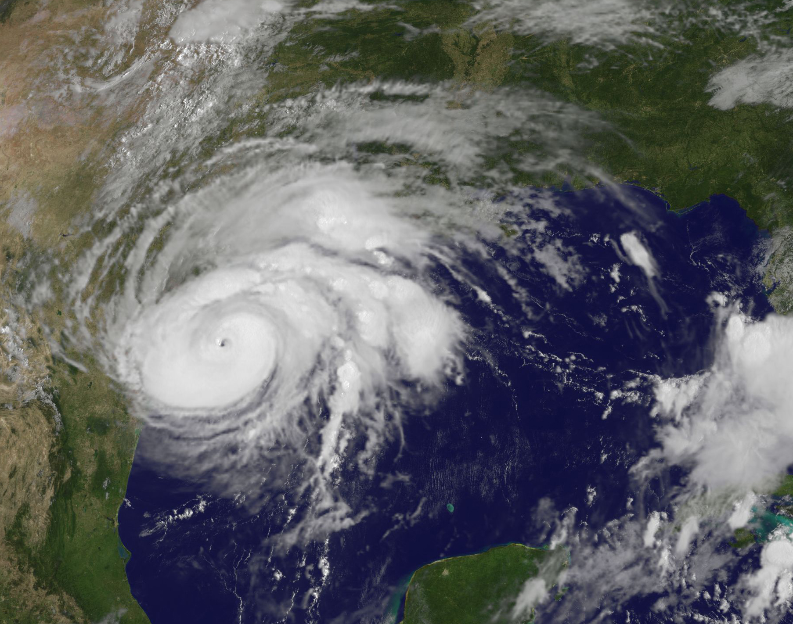
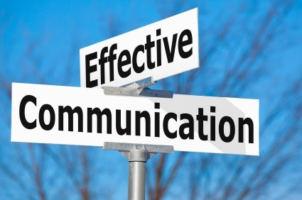
The Viability of Social Media for Communicating Risk: Interpretations of Experiences during 2017 Hurricane Harvey through Phenomenography
by
Susan E. Street, Ph.D.
R. Denise Blanchard, Ph.D.
Texas State University

Slide 2
Researchers
Denise Blanchard, Ph.D.
Professor
Emergency Management
Risk Communication/Public Ed.
Hazards and Disaster Research
Environmental Hazards
Susan Street, Ph.D.
Independent Scholar
Emergency Management
Social Media Research
Public Education and Information Dissemination: Weather and Risk

Slide 3
Social Media and Disasters: Early Examples
Malaysia Airlines Flight 370 crisis
The use of social media changed the timeframe for crisis communication responses by corporate officials, particularly for PR personnel.
Internal communications needed to be quicker in order to respond to external/public inquiries because the company’s reputation and brand were at stake.
External communications, such as Facebook, Twitter, and personal blogs were quick to share information about a crisis, good or bad, and posted any information they wished without considering journalistic boundaries or accuracy.
Husain et al. 2014

Slide 4
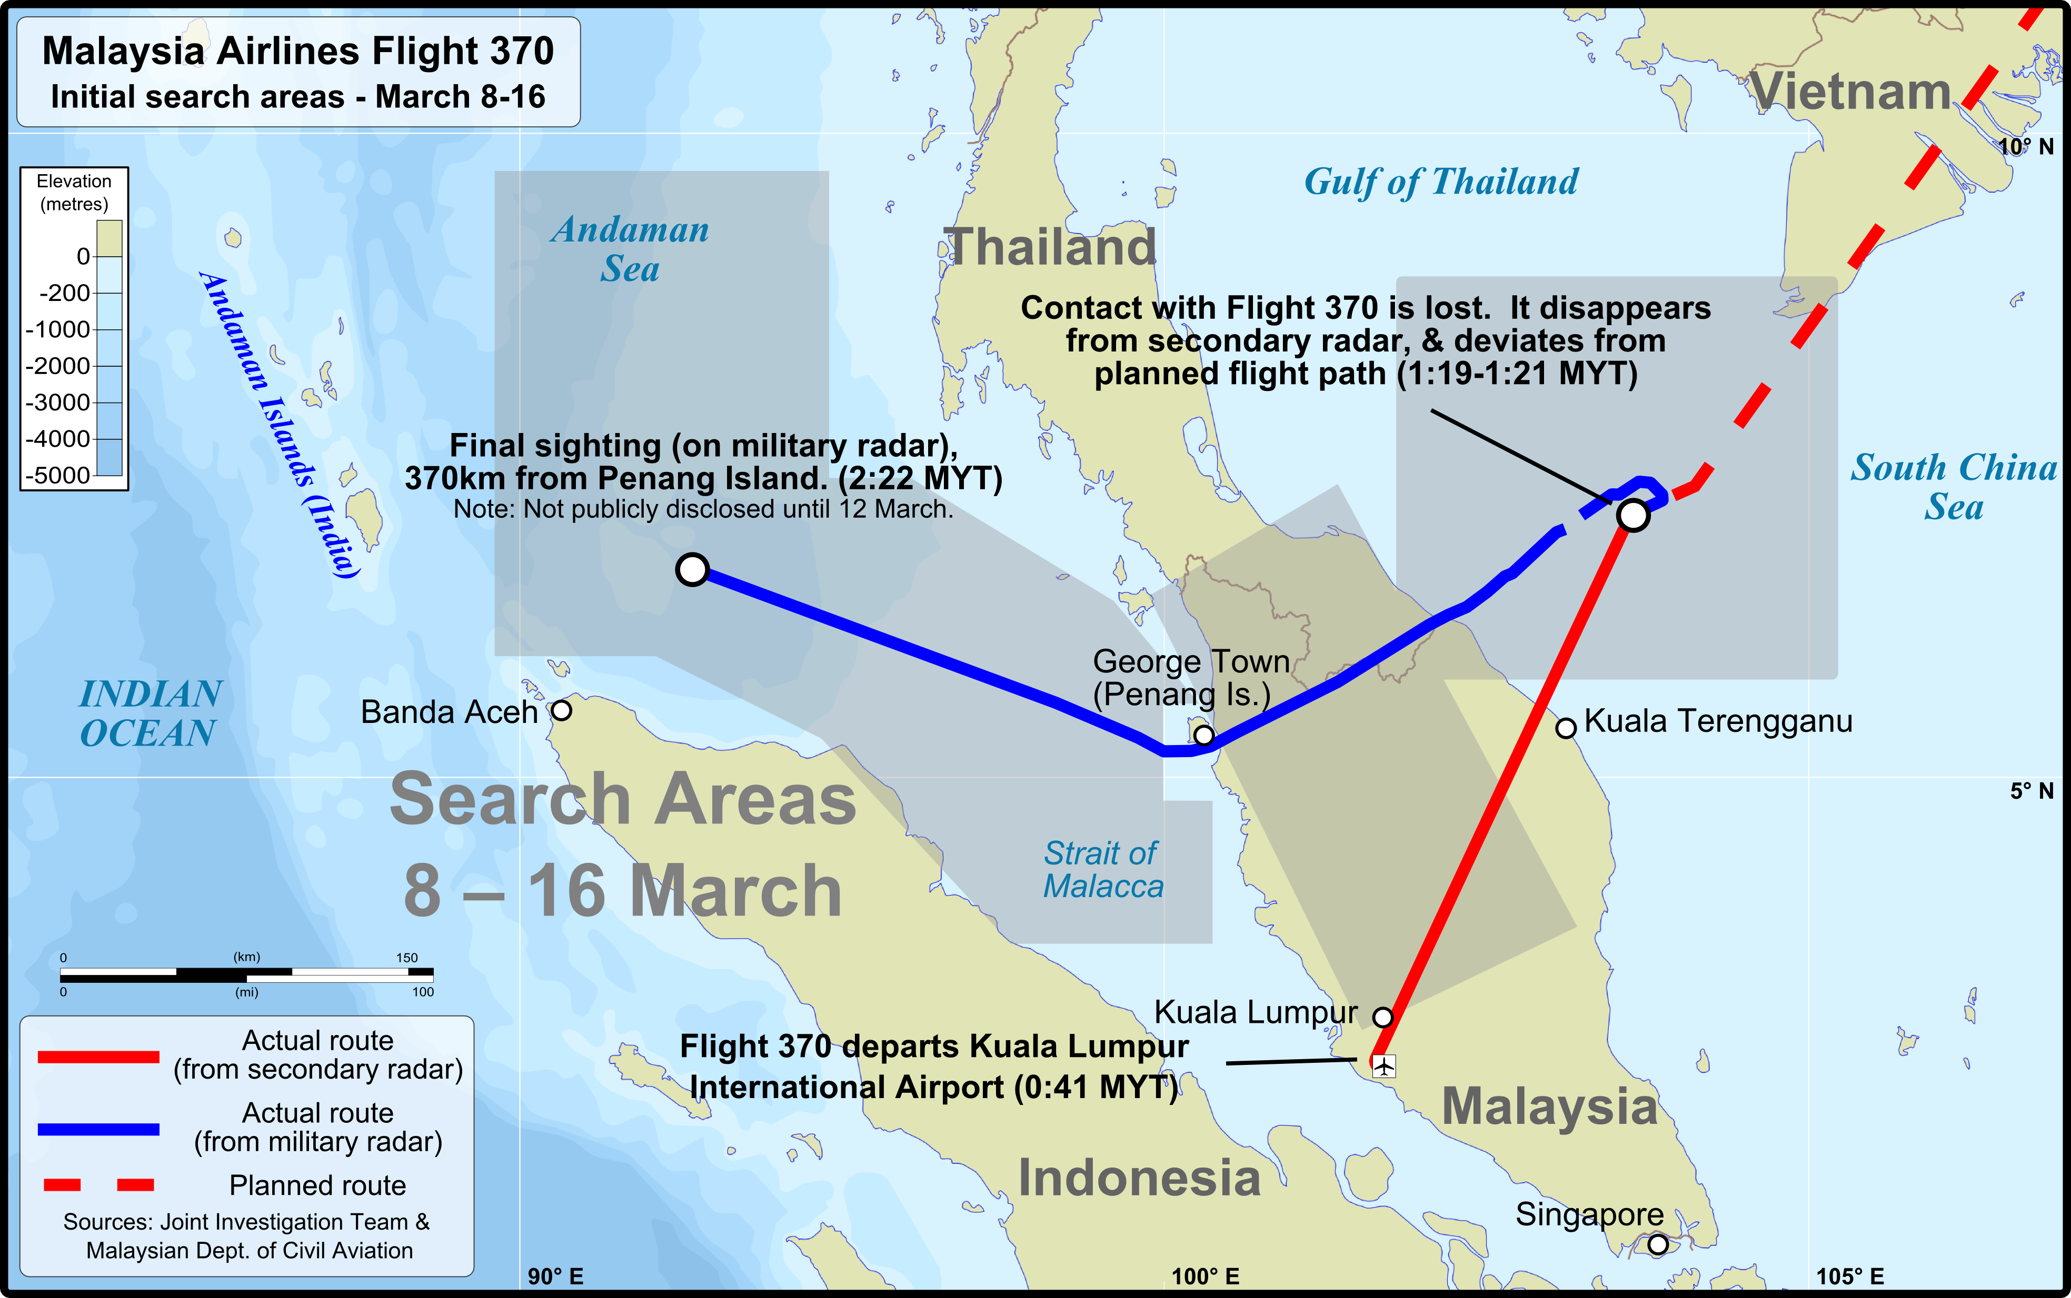

Slide 5
Since 2011 Hurricane Sandy and what other early studies have found . .
Distribution of emergency messages is timely.
Social Media provides real-time updates.
Messages change over the course of the event.
Social media helps manage crisis situations, esp. for underrepresented populations.
Social media allows for more organized crisis response.
Increases public participation.
Information travels fast on social media.
Often, there is much misinformation included in sharing.
Increased “Digital Volunteering” Activity.
Social media lets the first responders do their jobs.
https://www.columbiasouthern.edu/blog/june-2018/how-social-media-is-changing-emergency-response

Slide 6
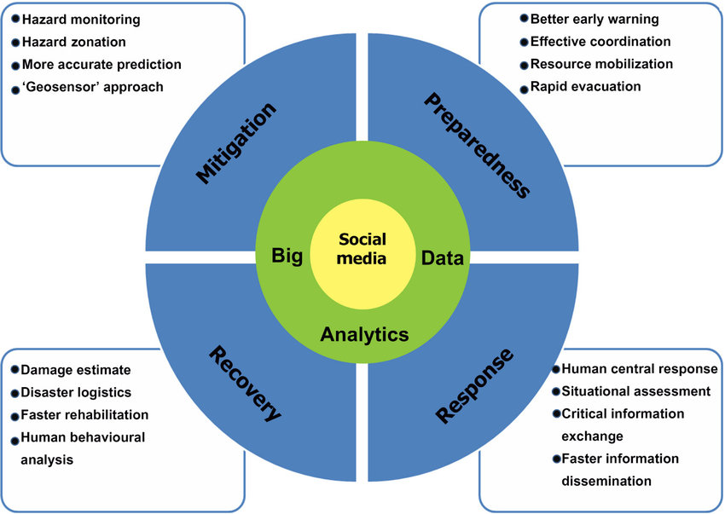
The Disaster Life Cycle and Social Media

Slide 7
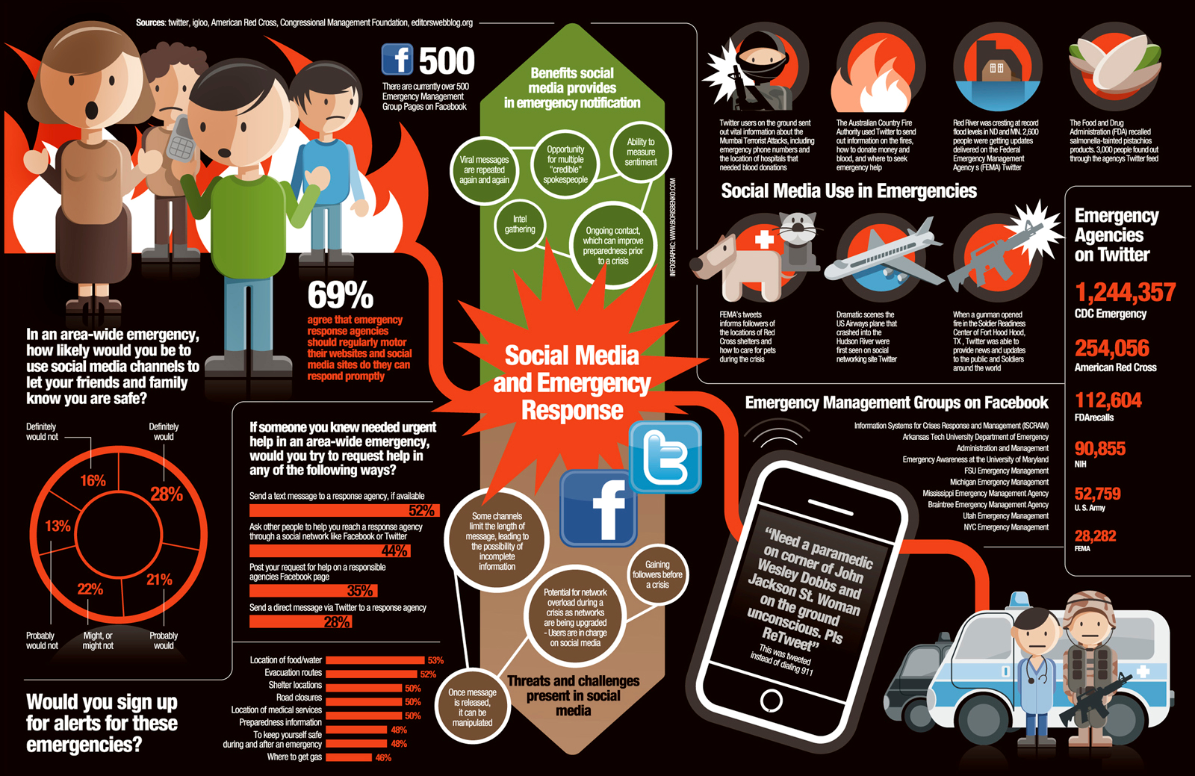

Slide 8
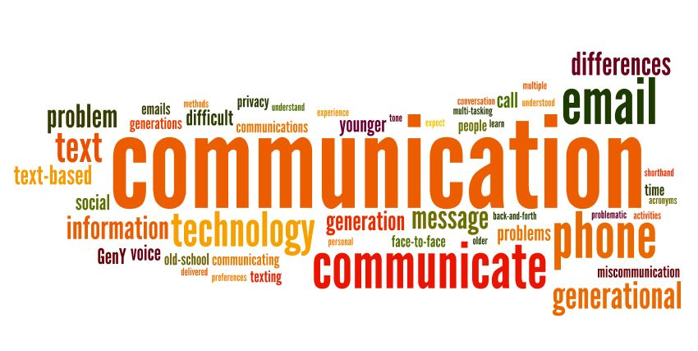
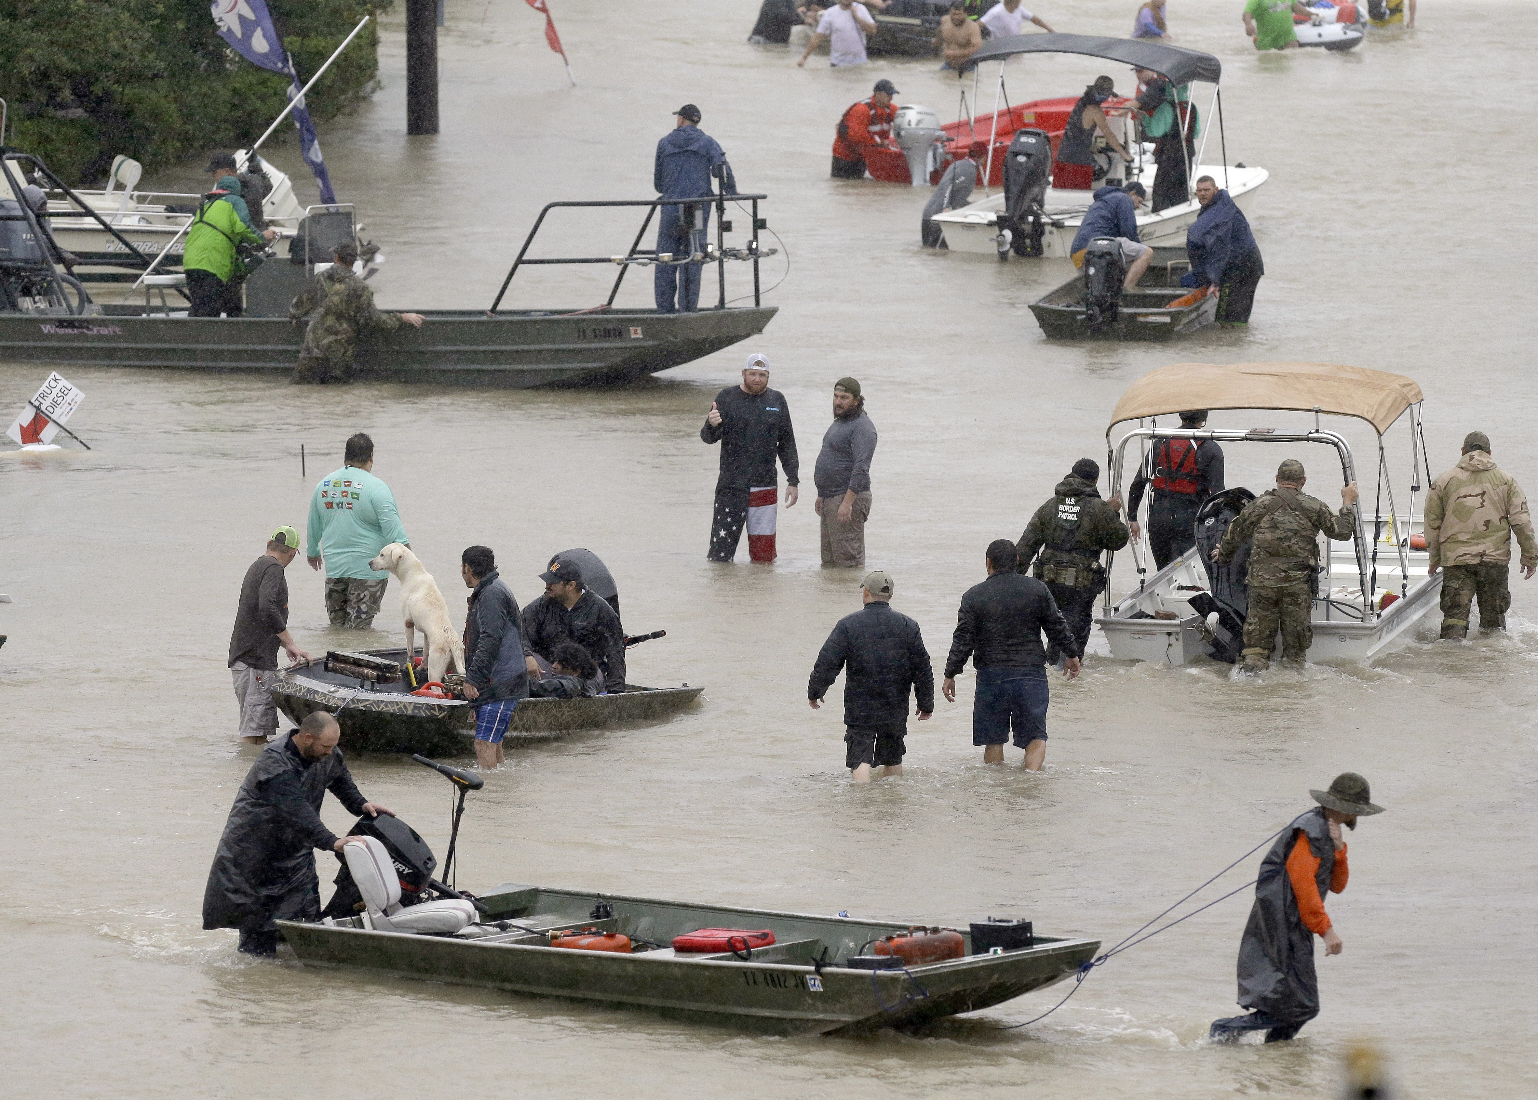
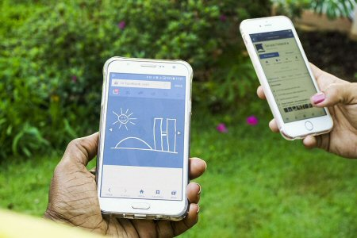
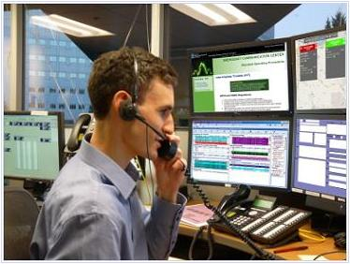
Hurricane Harvey: The U.S.’s First Social Media Storm
ttps://time.com/4921961/hurricane-harvey-twitter-facebook-social-media
Hurricane Harvey Victims Turn to Social Media
https://www.wsj.com/articles/hurricane-harvey-victims-turn-to-social-media-for assistance
People and rescue boats line a street at the east Sam Houston Tollway as evacuations continued from flooding in Houston on Monday.
Photo: Melissa Phillip/Associated Press

Slide 9
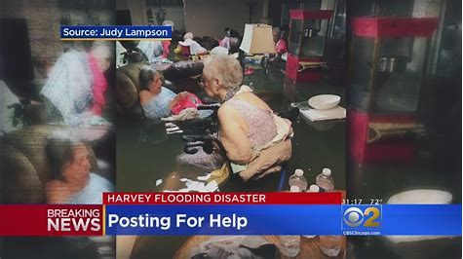
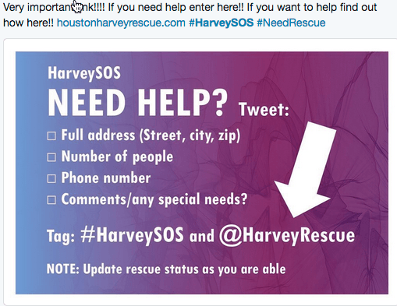
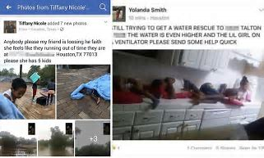
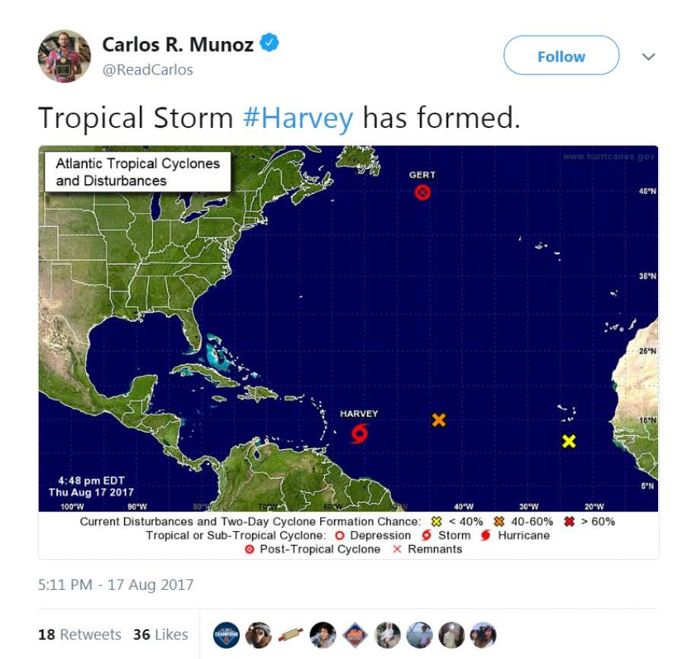
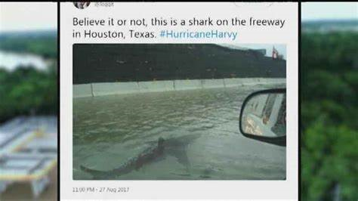
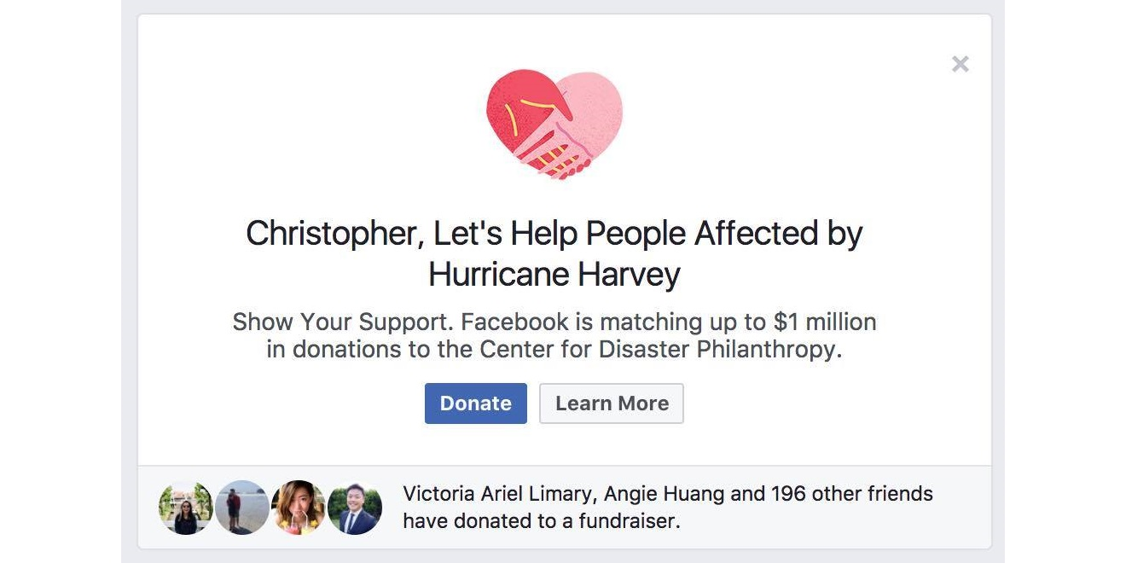
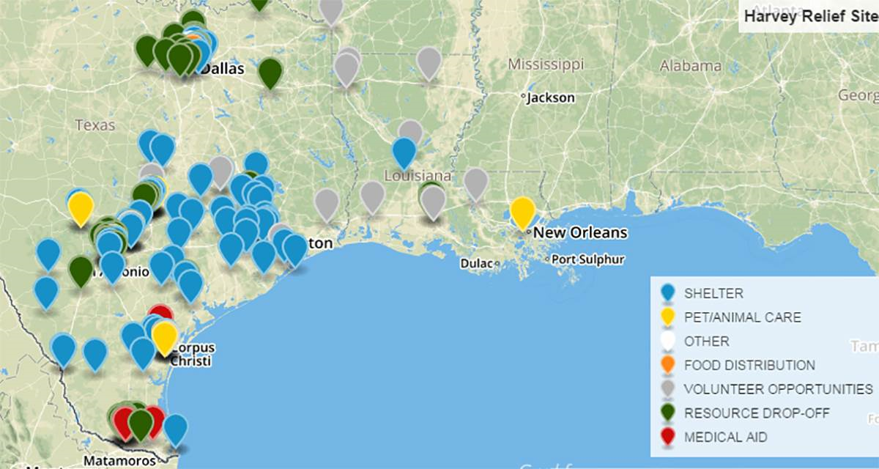
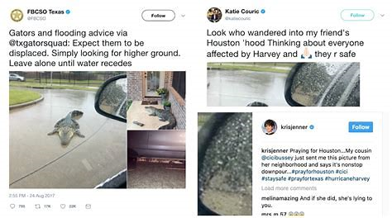
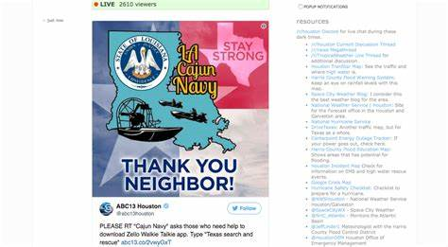

Slide 10
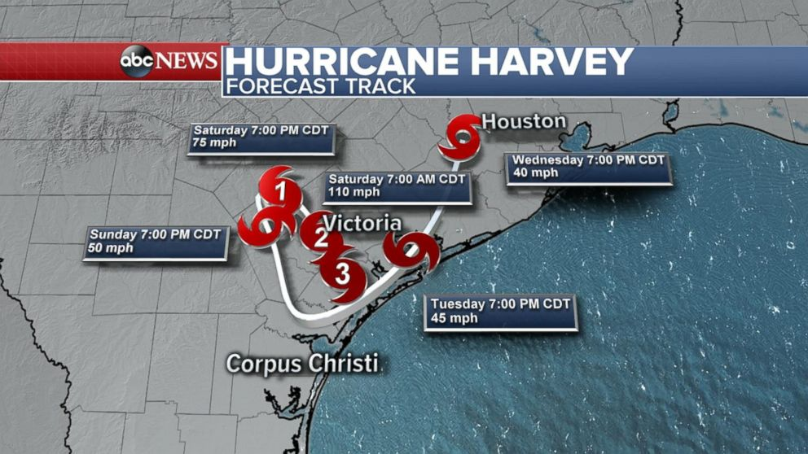
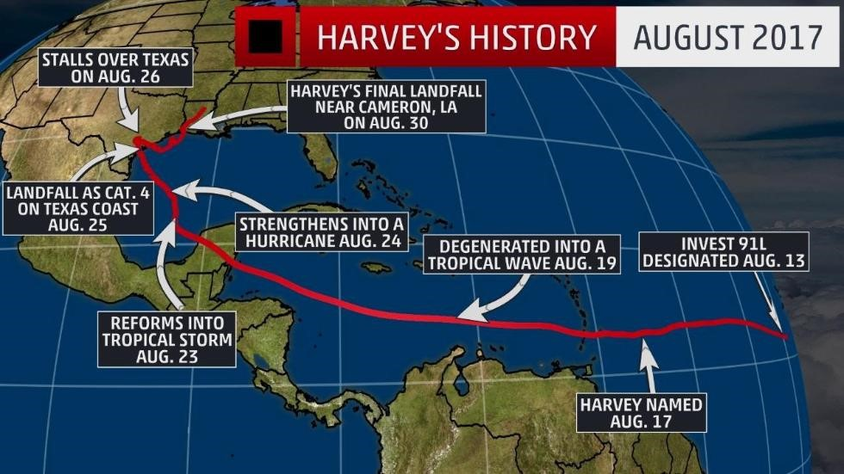
Hurricane Harvey: August 17 – September 1, 2017
Made Landfall: August 25, 2017
At approximately 10 p.m.
Category 4
Just east of Rockport, TX
Notes:
130+ mph

Slide 11
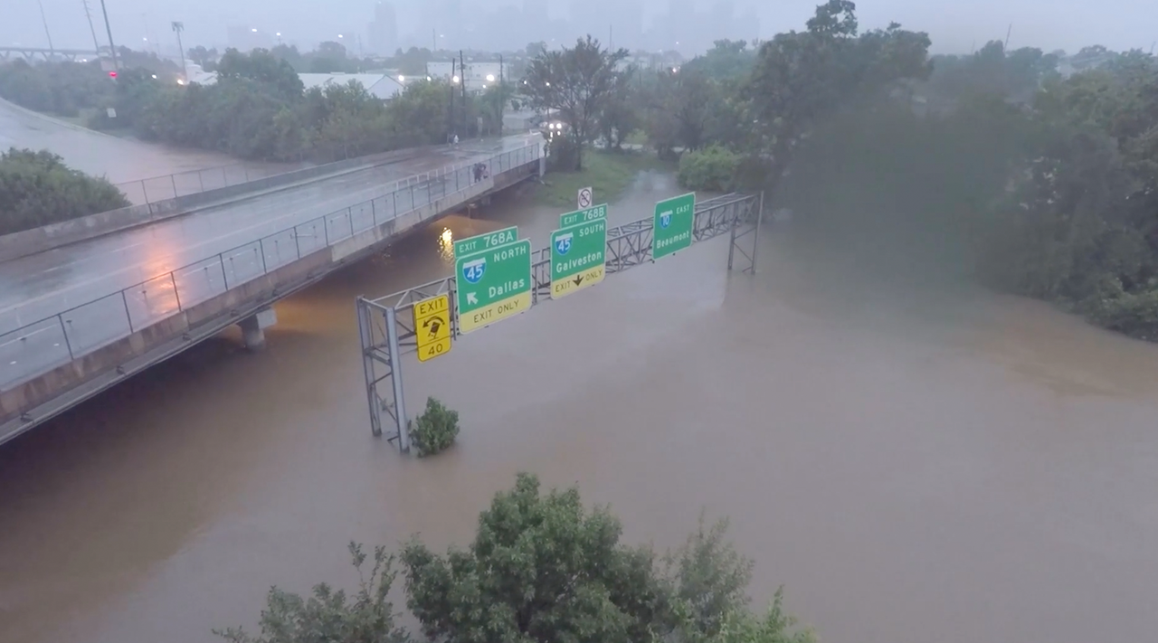
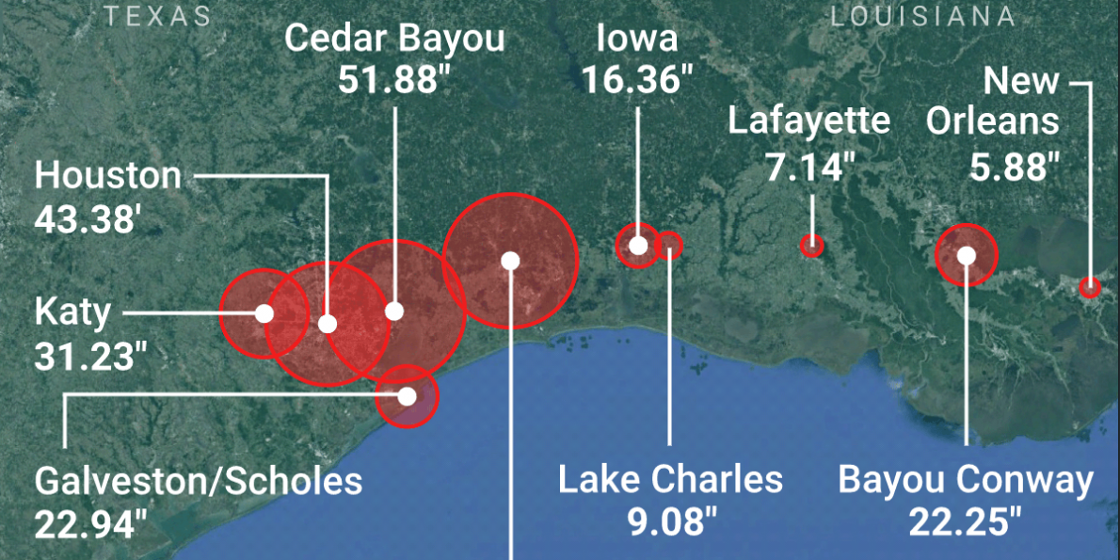
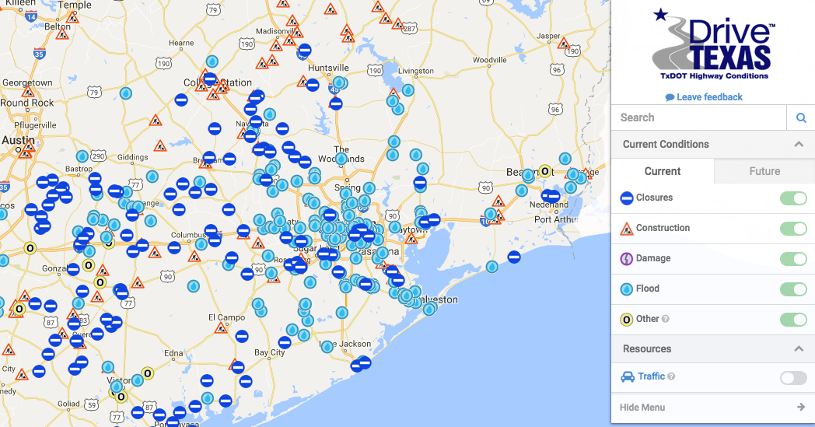
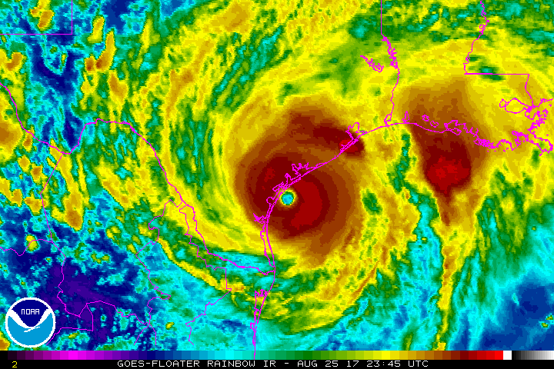
Hurricane Harvey…
Inches of Rainfall: August 24-August 31, 2017
https://www.worldvision.org/disaster-relief-news-stories/2017-hurricane-harvey-facts

Slide 12
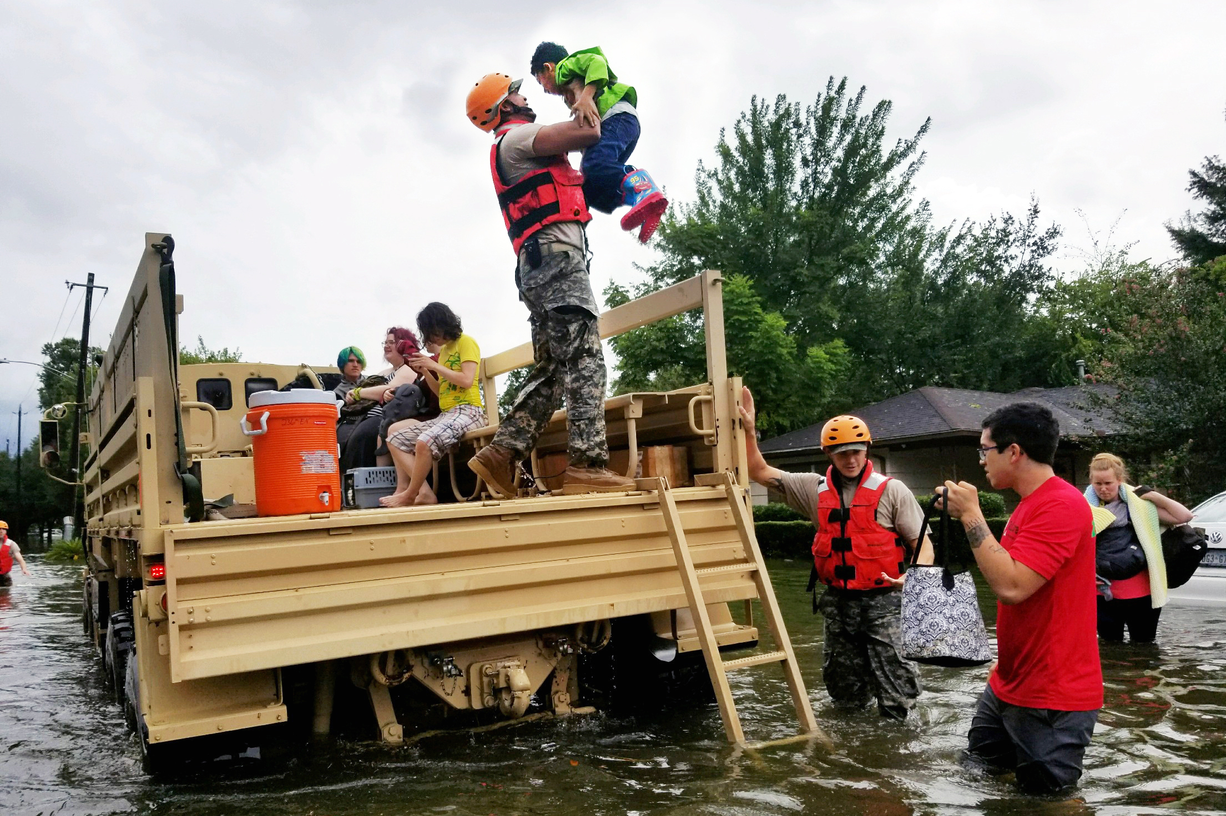
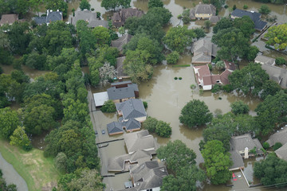
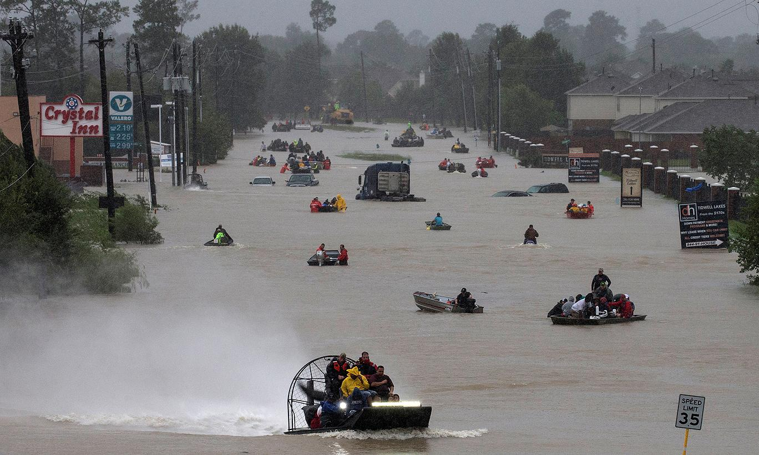
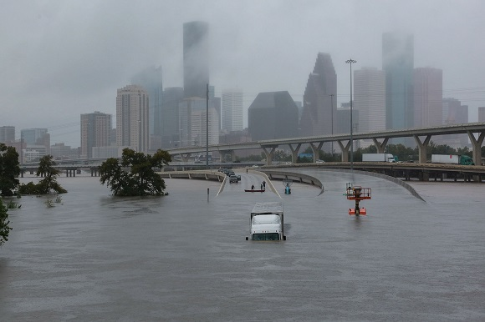
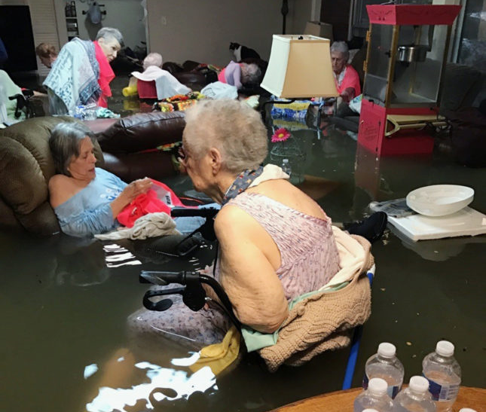

Slide 13
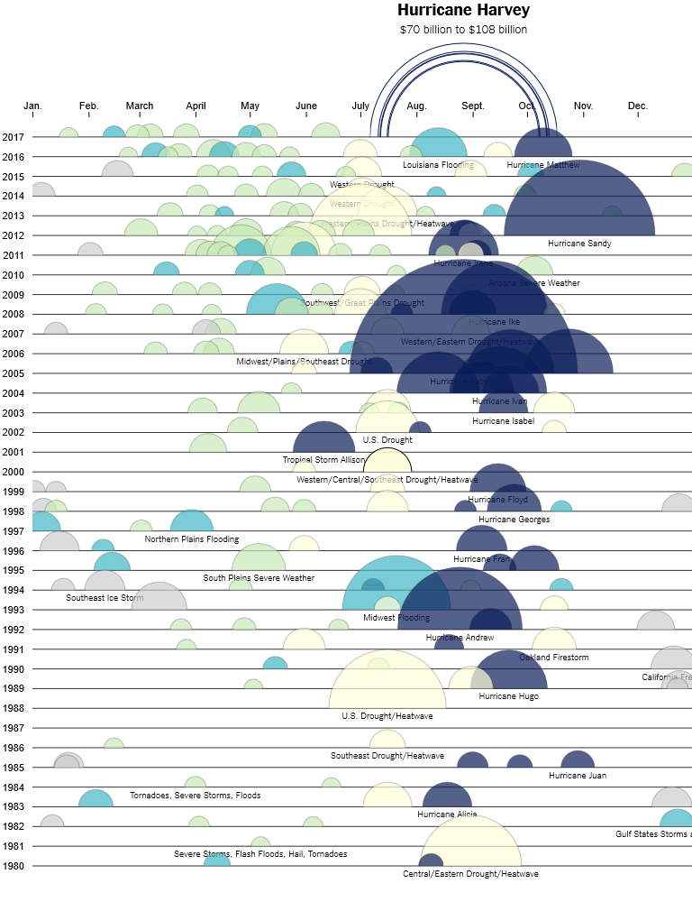
“The Cost of Hurricane Harvey: Only One Recent Storm
Comes Close”*
Billion-dollar natural disasters since 1980
(adjusted for inflation)
Circles are sized proportionally to their cost in 2017 dollars
Grey = Winter storms, freezing
Yellow = Drought and wildfire
Aqua = Flooding
Dk. Blue = Tropical cyclones
Green = Severe storms
https://www.nytimes.com/interactive/2017/09/01/upshot/cost-of-hurricane-harvey-only-one-storm-comes-close.html
*2005 Katrina - $160 billion in today’s dollars and resulted in 1,833 deaths.

Slide 14
Research Questions
To what extent did residents of the Houston-Galveston metro area use social media during Hurricane Harvey?
a) What was the process of risk communication involving social media?
b) Does the process of risk communication vary by specific demographic or personal need?
Notes:
Risk Communication – is providing information about a possible risk (type and magnitude) and what might be the future outcome for the individual, group, or community (Reynolds and Seeger 2014)

Slide 15
Research Questions (cont.)
2) To what extent did individuals believe that social media was an effective means of communicating immediate and urgent needs for assistance?

Slide 16
Research Questions (cont.)
3) To what extent did Emergency Management provide channels of information gathering during Hurricane Harvey?
a) How is social media instrumental in risk communication?
b) Which method is easiest, most difficult, most effective to use?
c) What are the positive and negative aspects of the methods for the social media used?

Slide 17
Research Questions (cont.)
4) How can the use of social media improve risk communication between governmental agencies and the affected public during a hazard event?

Slide 18
Importance of the Questions
They ask:
Why people used social media in this emergency
Did people think or perceive that social media was effective
How did emergency management personnel use social media
Can the application of social media be made more effective

Slide 19
Research Goals
1) To shed understanding and perspective on how and why social media was used by individuals (victims) during the Hurricane Harvey event;
2) To learn how individuals judged social media as an effective means of communicating immediate and urgent needs for assistance; and
3) To investigate and understand how emergency managers and other officials viewed and utilized social media as an effective communication tool for assistance during the hurricane event.

Slide 20
Methodology
Method – Qualitative
Why?
Exactly. I am looking for the ‘why’ or ‘how’.
Need open-ended questions, semi-structured interviews
Need explanations
Design – Phenomenography
Analysis is designed to find ‘categories of variations’ in responses
Looks for how people conceive or understand a phenomenon

Slide 21
Methodology (cont.)
Phenomenology Phenomenography
Experiences with phenomenon
Relationship with phenomenon
Analysis boils down to meaning
Analysis categorizes the variations of meaning
Meaning of phenomenon
How or why phenomenon was used

Slide 22
Methodology (cont.)
Process:
Interviews with 21 citizens and 4 emergency management personnel (Khan 2014, Trigwell 2006 suggested max 20)
Approximately 30-45 minutes each
All were in Houston for Hurricane Harvey and used social media at that time
Notes:
Enough variation should be available in 20 participants (Khan 2014, Trigwell 2006)

Slide 23
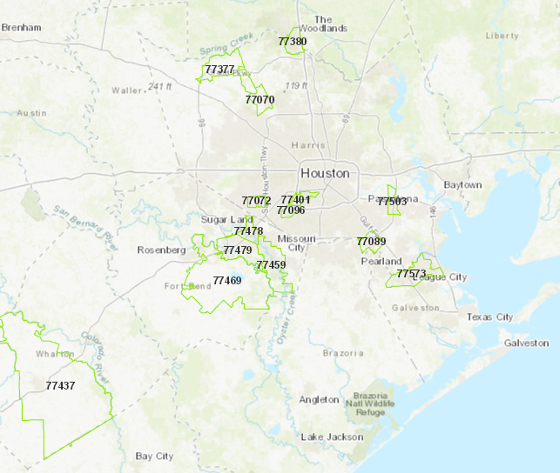
Methodology (cont.)
Demographics of participants by location (zip codes):
15 Zip Codes
Harris Co,
Fort Bend Co, Wharton Co,
Galveston Co,
Montgomery Co.

Slide 24
Analysis
Process:
Interviews were transcribed and entered into Nvivo 12 Plus for initial categorization by interview question
Transcripts were manually coded to look for themes/conceptions related to use of social media – Comments were categorized
Categories were grouped by themes/conceptions

Slide 25
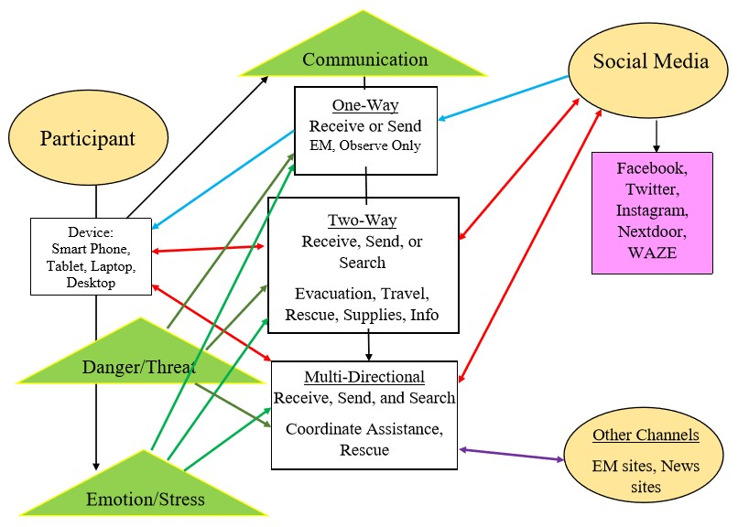
Results
Phenomenography: Relational Model of How and Why Social Media Was Used
Notes:
Visually applied Outcome Space

Slide 26
Results (cont.)
Research Questions Answered:
What was the Extent of Social Media Use by Citizens
A. Receiving information – official info, family/friends
B. Sharing information – official info, current situation
C. Searching for information – info not readily available

Slide 27
Results (cont.)
Research Questions Answered:
1a) What was the process of risk communication involved in using social media?
Access to smartphone, tablets, laptops, or desktop computers
Access to internet or Wi-Fi
Interacting with Facebook, Twitter, Instagram, Snapchat, Nextdoor, or WAZE

Slide 28
Results (cont.)
Research Questions Answered:
1b) How Did the Process Vary by Demographic or Personal Need?
Over 65 demographic was lacking, slow to adopt
Increased danger/threat made use of social media more imperative
The more urgent the need, the higher the probability of a person reaching out on social media when 9-1-1 is not available (Speilhofer et al. 2016)

Slide 29
Results (cont.)
Research Questions Answered:
2) To what extent did individuals believe that social media was a useful means of communicating immediate and urgent needs for assistance?
85% ranked social media as extremely useful (9 or10)
The more they knew, the more control they had over situation, particularly travel or evacuation
7 evacuated, 3 were rescued from their homes

Slide 30
Results (cont.)
Research Questions Answered:
3) The Extent that Emergency Management Provided Channels of Information Gathering
Very little – primarily monitored for rumors or incorrect info

Slide 31
Results (cont.)
Research Questions Answered:
3a) How was social media instrumental in risk communication?
Getting info out quickly – Some EMs use SM for warnings
Information was available when people were mobile – for those who subscribe to a phone application, or are looking for information
Information could be ‘shared’- wider range of communication

Slide 32
Results (cont.)
Research Questions Answered:
3b) Which method is easiest, most difficult, most effective to use?
Easiest – Twitter – hashtags made categorizing easier
Most difficult – Facebook – too much conversation
Most effective – Twitter and Nextdoor

Slide 33
Results (cont.)
Research Questions Answered:
3c) What were the positive and negative aspects of the social media methods used?
EM Personnel | Positive Aspects | Negative Aspects
EM 1001 | Use of social media carries a good image for the agency | Rumors move fast and are hard to control because so many are posting, and information moves so quickly
EM 1002 | Rumor control; can coordinate messages across platforms so that the same information is going out; could target neighborhoods with Nextdoor | Have to check for accuracy of messages going out because incorrect information can slip through; messages must be approved before posting
EM 1003 | Can post quick updates
EM 1004 | Can control the “message”; there is a time lag to update website, so social media is faster | Have one person to monitor, so not 24/7; can’t respond to every post as quickly

Slide 34
Results (cont.)
Research Questions Answered:
4) How can the use of social media improve risk communication between governmental agencies and the affected public during a hazard event?
48% (10/21) said emergency management did the best they could
Some wanted more targeted information
Some suggested more info on consequences of the heavy rainfall

Slide 35
Implications of Findings
Need more two-way communication – with individuals and groups
Waiting on hold for 9-1-1 operators was unacceptable
Lack of full-time (24//7) social media staffing should be addressed
Monitoring software should be considered

Slide 36
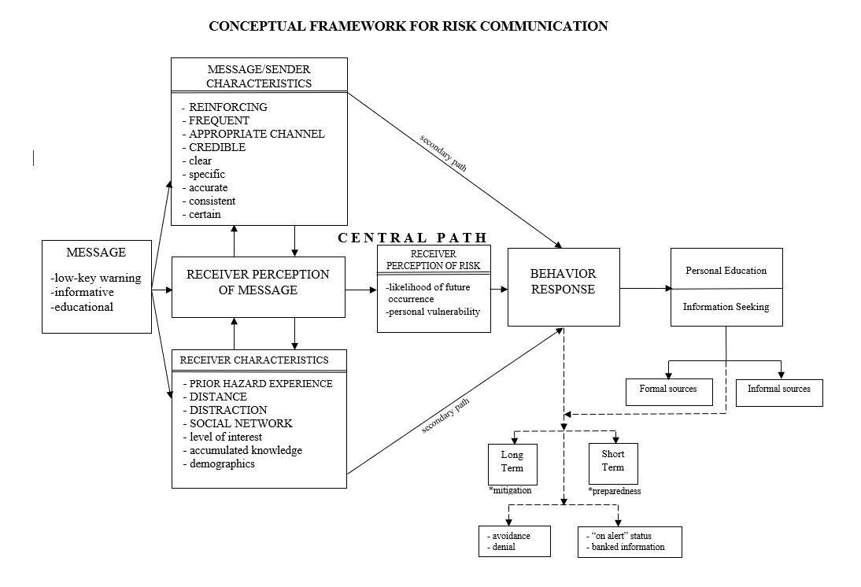
Future Directions
Conceptual Framework for Risk Communication – from Blanchard (1992)

Slide 37
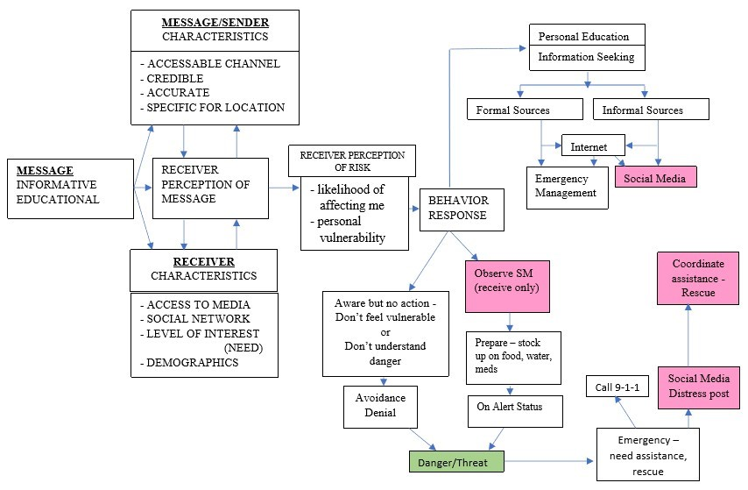
Future Directions
Conceptual Framework for Risk Communication – Adapted from Blanchard (1992)

Slide 38
Future Directions (cont.)
New channels for risk communication are available – Open Source Mapping (OSM), more apps, or improved apps
Larger study to include a broader spectrum of socio-economic participants - specified zip codes, neighborhoods, or congressional district
Comparing social media platforms for effective messaging
Vulnerable populations included to assess needs with regard to social media usage – over 65, special needs, hearing or visually impaired

Slide 39
Future Directions (cont.)
Who needs this information?
Emergency Management Agencies,
First Responder Control Centers,
Other Researchers
Why?
Research Questions Answered:
3a) How was social media instrumental in risk communication?
Getting info out quickly
Information was available when people were mobile
Information could be ‘shared’- wider range of communication

Slide 40
Conclusion
Many people in the Houston-Galveston metro area had dire need for information or assistance during Hurricane Harvey
They could not get through to 9-1-1, so turned to social media for help
Participants and emergency management personnel thought social media was effective tool
Some agencies are recognizing the need for social media presence, but more resources are needed – staff, software, technology

Slide 41
Conclusion
Emergency management agencies may consider social media monitoring to aid in coordinating with private citizens who can assist – grassroots groups that spring up in an emergency, Cajun Navy, church groups, etc.

Slide 42
Questions?

Slide 43
Results (cont.)
Intention: “WHY” Themes | The ACT (the “How” of Turning to Social Media) Structure
 | 1) Receiving information | 2) Sending (sharing) information | 3) Searching for information
Role of Communication
One-Way | X | X | X
Two-Way |  | X | X
Multi-directional |  | X | X
Role of Danger/Threat
Weather | X | X | X
Flood | X | X | X
Travel | X | X | X
Role of Emotion/Stress
Environmental | X | X | X
Personal | X | X | X
Phenomenography: Final Outcome Space
(Notes the range of experiences
in this particular situation)

Slide 44
Methodology (cont.)
Phenomenography – (Marton 1981, Trigwell 2006)
applied to learning and teaching phenomenon (Europe)
Empirical (observation or experience)
Structured to define ‘distinctiveness’ (Marton and Booth 1997)
Few categories, variety of experiences

Slide 45
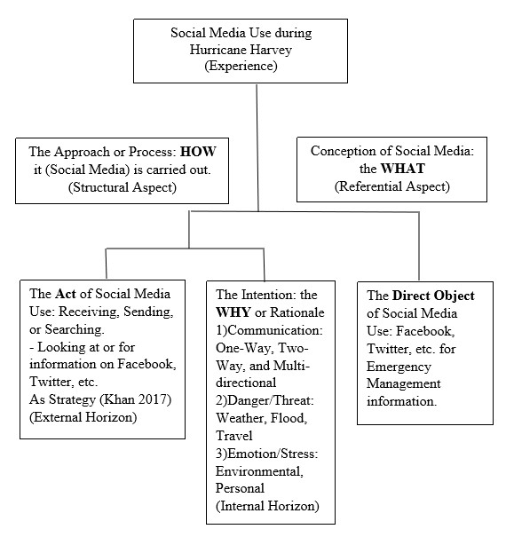
Methodology (cont.)
Phenomenography:
Khan’s Component of Experience (2014)(adapted)

Slide 46
Results (cont.)
Robust and Reliable:
Reproducible- A different researcher could interview participants, same procedures, with similar results
Replicability- A different group of participants can be chosen, same procedures, with similar results
Generalizability- use participants from a different location or hazard event, same procedures, with similar results

Slide 47
Methodology (cont.)
PHENOMENOLOGY | PHENOMENOGRAPHY
Definition: to understand someone’s experience; the essence of the phenomenon | Definition: to describe the ways that someone perceives or understands a phenomenon
Similarities
Looks at a phenomenon | Looks at a phenomenon
Exploratory in nature | Exploratory in nature
Relationship between person and phenomenon | Relationship between person and phenomenon
Purposive sampling – selective/subjective | Purposive sampling – selective/subjective
Differences
Homogeneous sample – people with similar characteristics | Heterogeneous sample – people don’t have same characteristics, but have a wide range of experience with the phenomenon
Unstructured questionnaire | Semi-structured questionnaire
Condenses information to the primary understanding of the phenomenon | Categorizes the variations of the phenomenon-focused on conceptions of phenomenon, not the phenomenon, itself

Slide 48
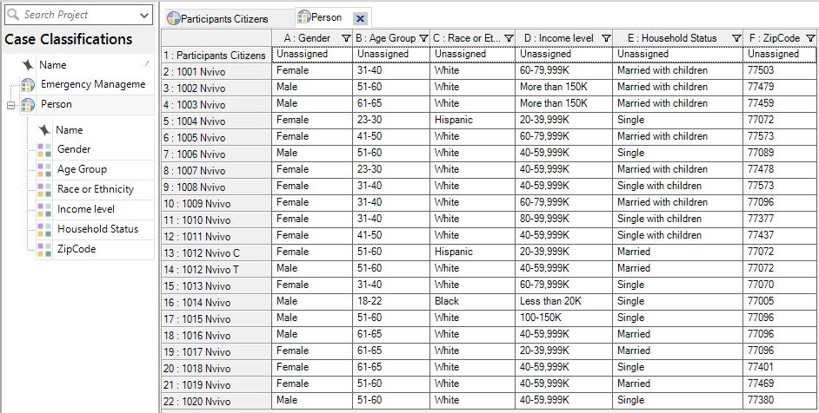
Methodology (cont.)
M -8
F -13
Married - 5
Mar w/ch - 6
Single - 3
Sing w/ch -7
Age Group
18-22 - 1
23-30 - 2
31-40 - 5
41-50 - 2
51-60 - 7
61-65 - 4
Demographics of participants:

Slide 49
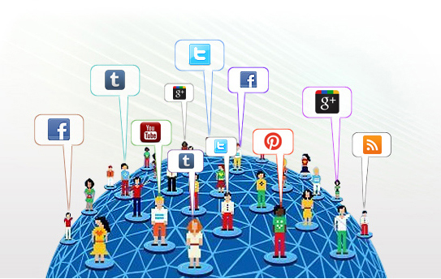
Introduction
Topic of this research
About Hurricane Harvey
Research questions and their importance
Goals of the research
Methodology
Results
Implications of Findings
Future Directions
Conclusion

Slide 50
Introduction
Topic: Social Media Use during Hurricane Harvey

Slide 51
Hurricane harvey
August 17 – September 1, 2017
Landfall: August 25, 2017, approximately 10 p.m. as Cat.4
Just east of Rockport, Tx.
Notes:
130+ mph

Slide 52
Introduction
Hurricane Harvey…
Inches of Rainfall: August 24-August 31, 2017
47.35” Beaumont/ Port Arthur

Slide 53
Hurricane harvey

