Slide 1
Climbing the Convergence Pyramid: From Communicating to Co-Creating w/ Disaster Researchers
Scott Miles
Director, Impact360 Alliance
Senior Research Scientist,
University of Washington,
Dept. Human Centered Design & Engineering

Slide 2
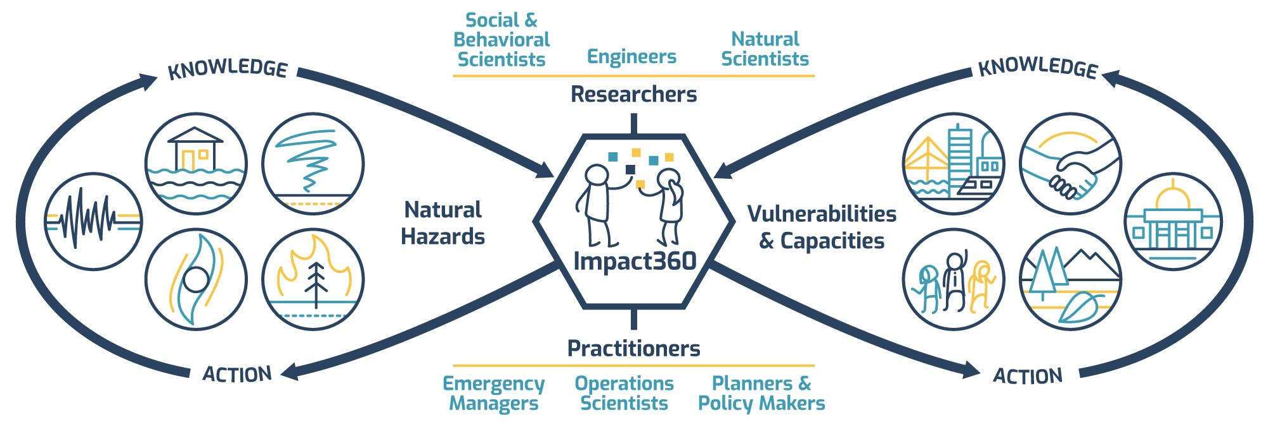
Activate and sustain a needs-based cycle of knowledge-to-action and action-to-knowledge
©2019 Impact360 Alliance. All rights reserved.

Slide 3
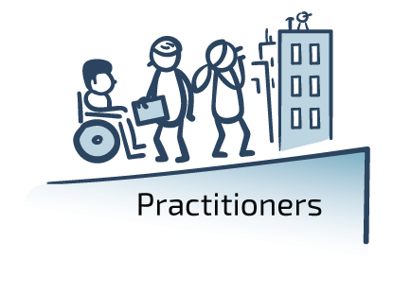

Slide 5
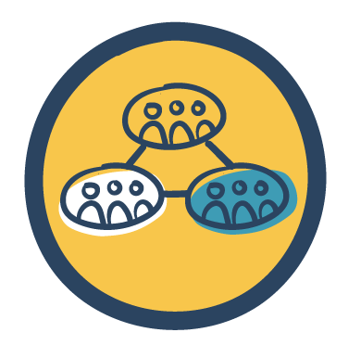
Develop tools for researchers & practitioners to...
...to reduce natural hazards impacts and disaster risk.
Strengthen connections
Integrate approaches
Inclusively solve problems
©2019 Impact360 Alliance. All rights reserved.

Slide 6
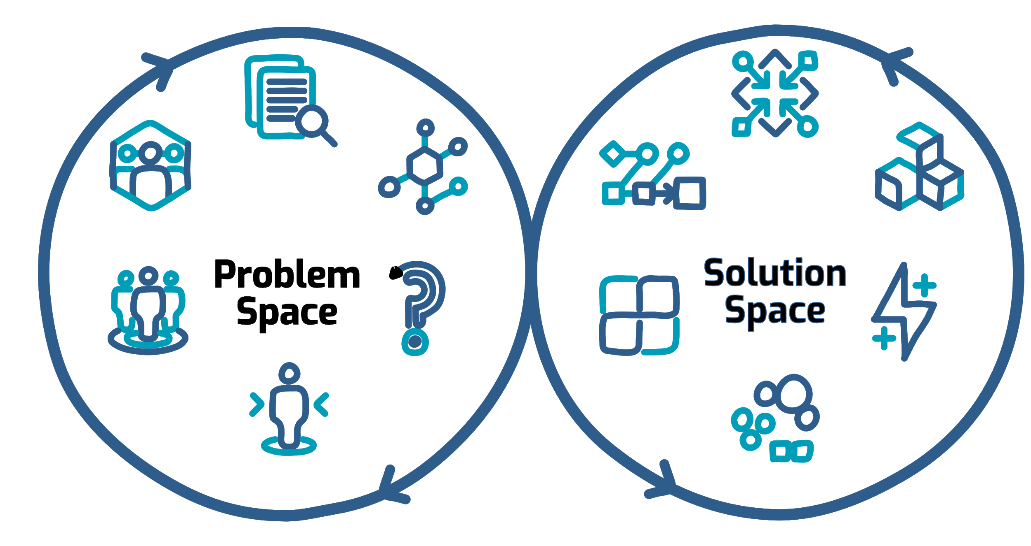
Inclusive Problem-Solving
©2019 Impact360 Alliance. All rights reserved.

Slide 7
Inclusive Problem-Solving Vision and Principles
Vision
A rigorous, intentional series of processes to inclusively amplify researcher and practitioner capacity to CLIMB THE CONVERGENCE PYRAMID together.
Principles
Include the excluded
Foster existing capacity
Build new capacity
Align participants
Enhance understanding
Ensure rigor
Drive implementation
©2019 Impact360 Alliance. All rights reserved.

Slide 8
“Convergence is an approach to problem solving that cuts across disciplinary boundaries.”
-- National Research Council (2014)

Slide 9
Converge
Levels of
Capacity Building & Engagement for Inclusive Problem-Solving
Co-create
Collaborate
Convergence Pyramid
Cooperate
Coordinate
Communicate
©2019 Impact360 Alliance. All rights reserved.

Slide 10
Converge
Iteratively Increase the Intensity of Inclusive Problem Solving to Climb the Convergence Pyramid
Co-create
Collaborate
Convergence Pyramid
Cooperate
Coordinate
Communicate

Slide 11
Converge
Translation and Knowledge Transfer is Not Enough
Co-create
Collaborate
Convergence Pyramid
Cooperate
Coordinate
Communicate

Slide 12
4I’s for Researcher-Practitioner Communications

Slide 13
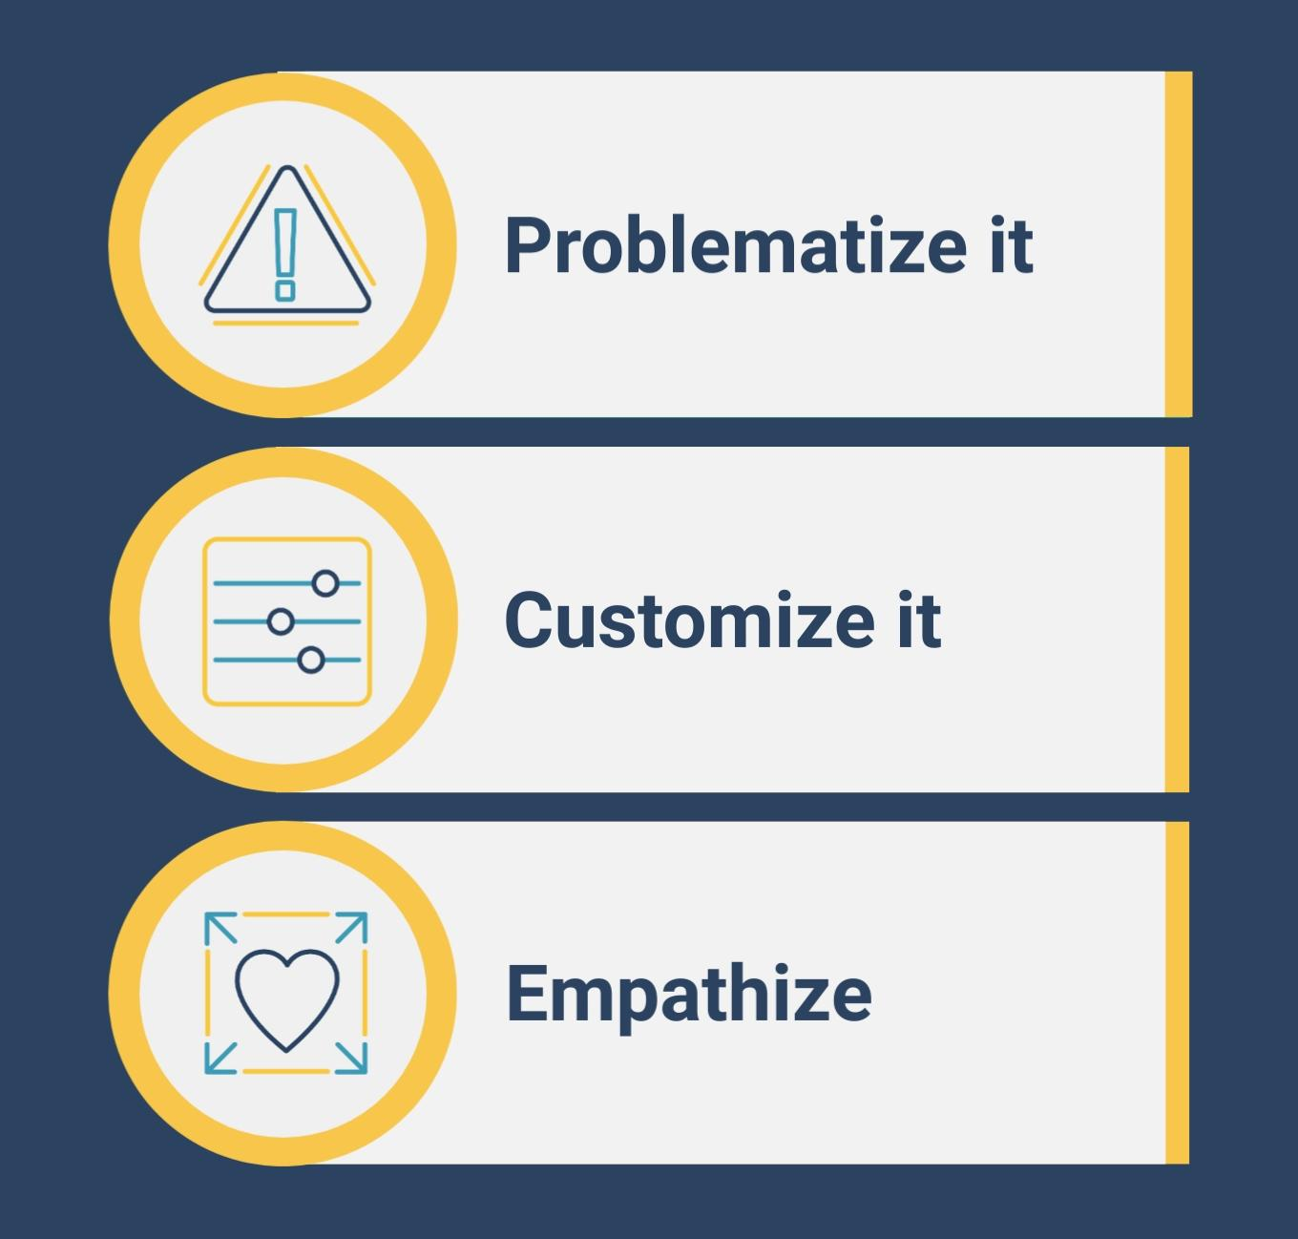
4I’s for Researcher-Practitioner Communications

Slide 14
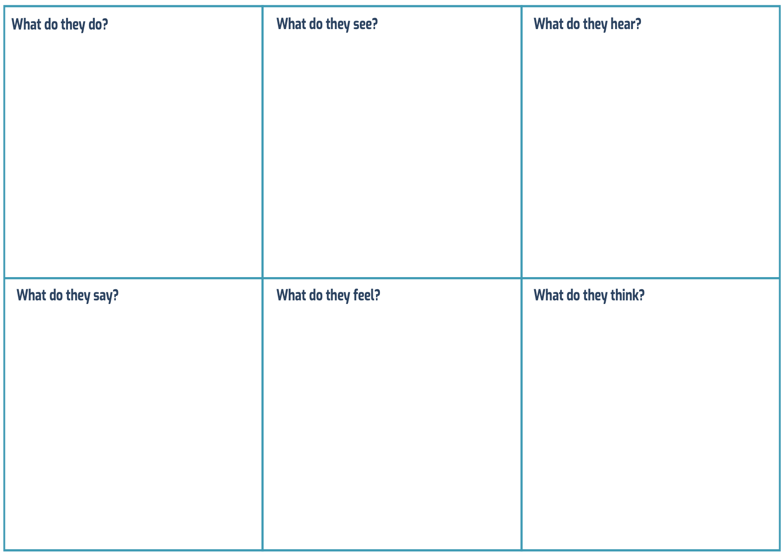
Empathy Mapping

Slide 15
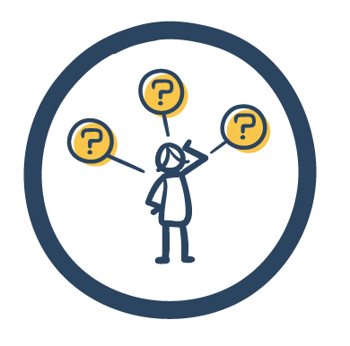

Slide 16
Who’s Included in Inclusive Problem- Solving?
“Researchers” &
“Practitioners”
not nuanced
enough to support climbing the convergence pyramid
Need to leverage common capacities & interests to climb all
five convergence levels
©2019 Impact360 Alliance. All rights reserved.

Slide 17
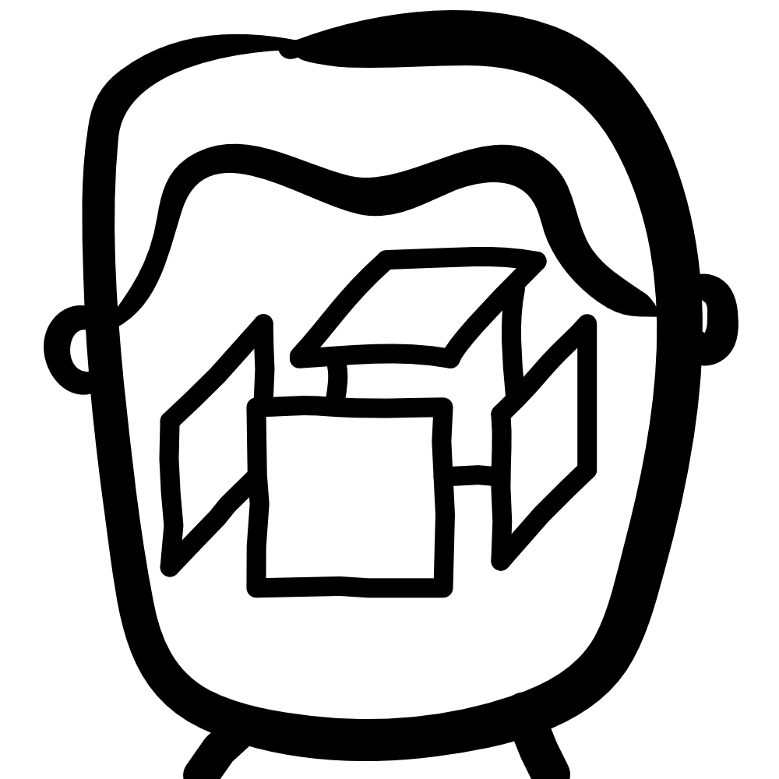
Thinker
Impacter
Tinkerer
Solver
©2019 Impact360 Alliance. All rights reserved.

Slide 18
Thinker
Impacter
Tinkerer
Solver
©2019 Impact360 Alliance. All rights reserved.

Slide 19
Big Scale
Thinker
Impacter
Problem
Understander
Solution
Maker
Tinkerer
Solver
Small Scale
©2019 Impact360 Alliance. All rights reserved.

Slide 20
Convergence
Personas
(Personality Archetypes)
Big Scale
Thinker
Impacter
Problem
Understander
Solution
Maker
Spanner
Tinkerer
Solver
Small Scale
©2019 Impact360 Alliance. All rights reserved.

Slide 21
Big Scale
Thinker
Impacter
Spanner
Tinkerer
Solver
Small Scale
©2019 Impact360 Alliance. All rights reserved.

Slide 22
Thinker
“A knowledge generator who uses proven systematic methods.”
Vision
A systematic, collaborative process to integrate evidence, critique ideas, and activate deep understanding of the problem.
Principles
Share their findings
Incorporate scientific evidence
Facilitate rigorous thinking
Provide time to think
Activate their knowledge
©2019 Impact360 Alliance. All rights reserved.

Slide 23
Impacter
“A champion that sparks systemic change and rights wrongs.”
Vision
A fair, empathetic process that breaks down visions for change to make them achievable.
Principles
Ensure fairness and equity
Build empathy and trust
Reveal wrongs
Provide a platform for inspiring
Make change possible
©2019 Impact360 Alliance. All rights reserved.

Slide 24
Tinkerer
“A decoder that dissects things to quickly figure out how they work.”
Vision
A flexible, exploratory process for collaboratively taking things apart and putting them back together again.
Principles
Present things to tinker with
Provide more and better tools
Provide evidence to leverage
Allow to take things apart
Put things back together
©2019 Impact360 Alliance. All rights reserved.

Slide 25
Solver
“A solutions generator that knows what to do next and does it.”
Vision
A creative, productive process to reframe problems in a way that unleashes new ideas.
Principles
Unpack the problem
Inspire ideas with new frames
Release their energy
Facilitate process to build buy-in
Ensure consistent improvement
©2019 Impact360 Alliance. All rights reserved.

Slide 26
Spanner
“A generalist and interpreter that can clarify almost anything.”
Vision
A repeatable, standardized process for integrating knowledge, finding alignment, and fostering co-creation.
Principles
Integrate people and perspectives
Build alignment
Give opportunities to translate & interpret
Facilitate co-creation
Iterate the standardized process
©2019 Impact360 Alliance. All rights reserved.

Slide 27
©2019 Impact360 Alliance. All rights reserved.

Slide 29
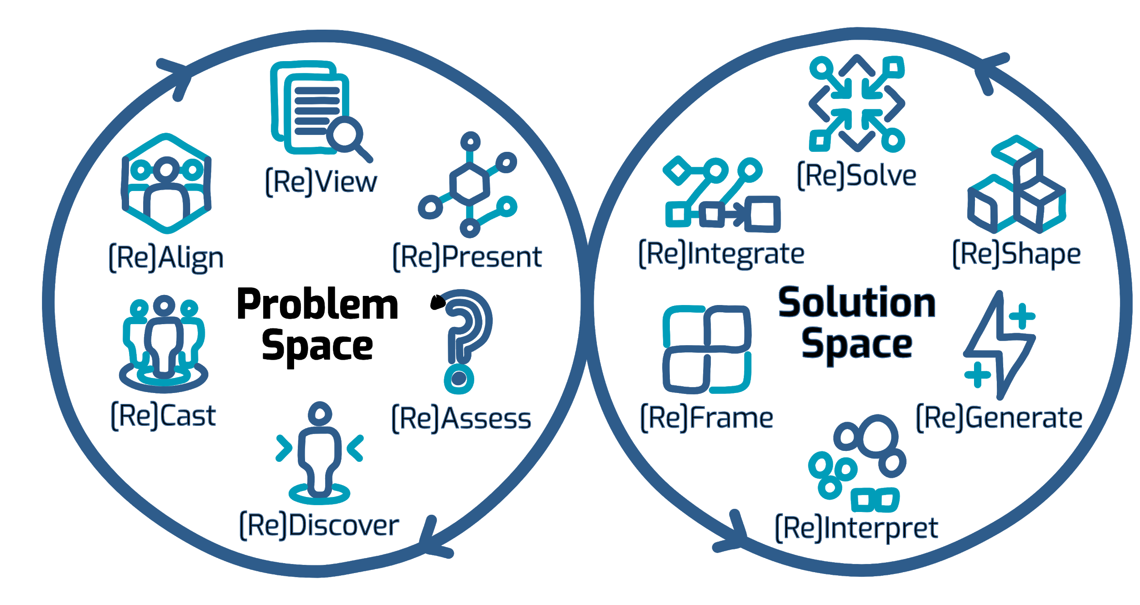
Inclusive Problem-Solving Process
Typical
[Re]Conclude
Typical
[Re]Begin
©2019 Impact360 Alliance. All rights reserved.

Slide 30
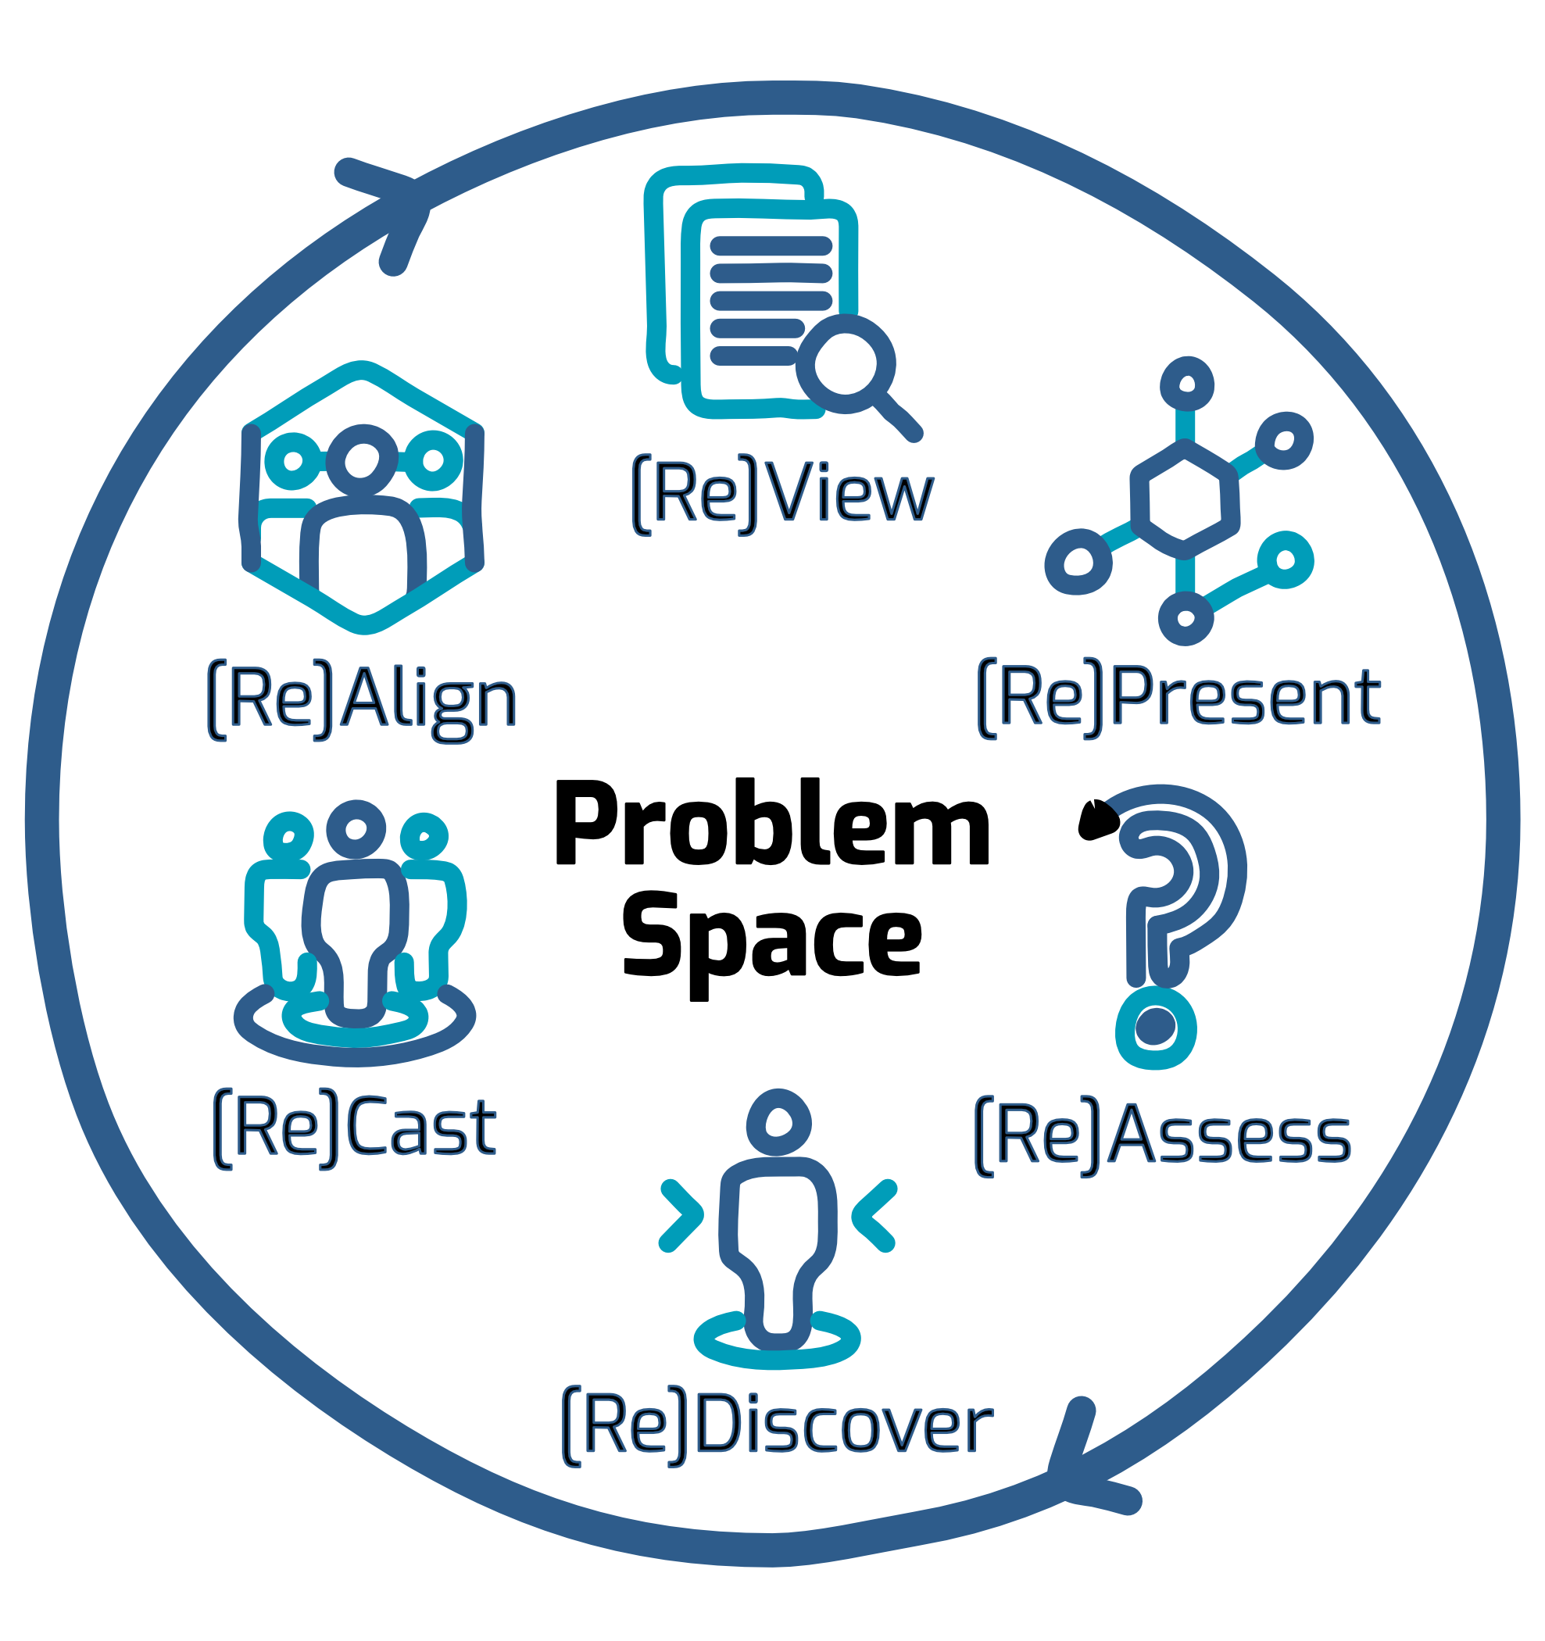
Engage and Understand
©2019 Impact360 Alliance. All rights reserved.

Slide 31
Problem Space Tools
[Re]Assess the roots, stakeholders, and implications of the problem situation, Inventory past (lack of) successes. Identify tensions of research and practice.
[Re]Discover and activate primary observations, opinions, experiences, needs, and expectations of included and excluded stakeholders and experts.
[Re]Cast the alliance of included conveners, stakeholders and experts. Define what inclusion means. Outline how those included will be afforded participation.
©2019 Impact360 Alliance. All rights reserved.

Slide 32
Problem Space Tools
[Re]Align participants around a shared understanding of individual values, goals, and interests for the problem situation, as well as their disparate ways of knowing and working.
[Re]View and activate relevant interdisciplinary research literature, best practices, operational procedures, case studies, and other evidentiary sources from research and practice.
[Re]Present the complex system of the problem situation based on synthesis of evidence from [Re]Assess, [Re]Discover, and [Re]View in a meaningful, interpretable way for all participants.
©2019 Impact360 Alliance. All rights reserved.

Slide 33
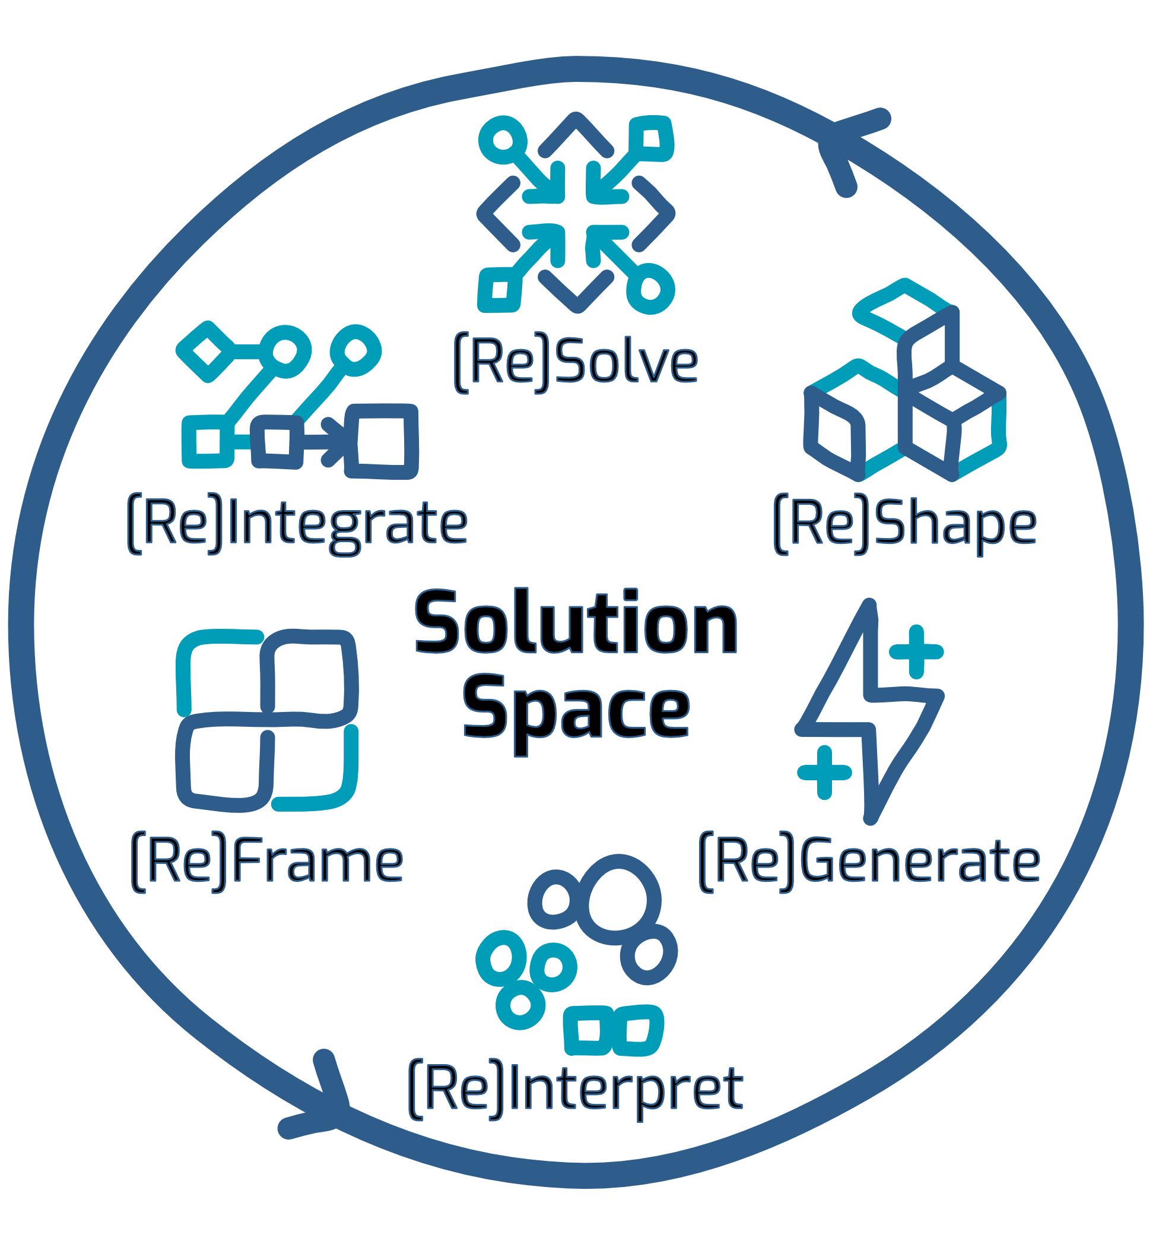
Design & Strategize
©2019 Impact360 Alliance. All rights reserved.

Slide 34
Solution Space Tools
[Re]Frame the definition and perceptions of the problem with an interdisciplinary lens. Create evocative ways of seeing the problem that point to new opportunities for solutions.
[Re]Interpret the problem definition, goals, evidence, and stakeholder needs using creative, discipline-agnostic framings to find new integrative patterns, themes, and priorities.
[Re]Generate and select bold transdisciplinary concepts, evidence-based conjectures, and competing hypotheses to inform prototype solutions.
©2019 Impact360 Alliance. All rights reserved.

Slide 35
Solution Space Tools
[Re]Shape evidence-based prototypes (sketches, mockups, proxies, interactions etc.) using integrative approaches in order to test the assumptions and hypotheses of proposed solutions.
[Re]Solve which assumptions and hypotheses embedded in the prototypes are valid through rapid, iterative testing.
[Re]Integrate the tested strategy to be compatible with relevant institutional and organizational cultures, structures, workflows, decision processes, and resources.
©2019 Impact360 Alliance. All rights reserved.

Slide 36
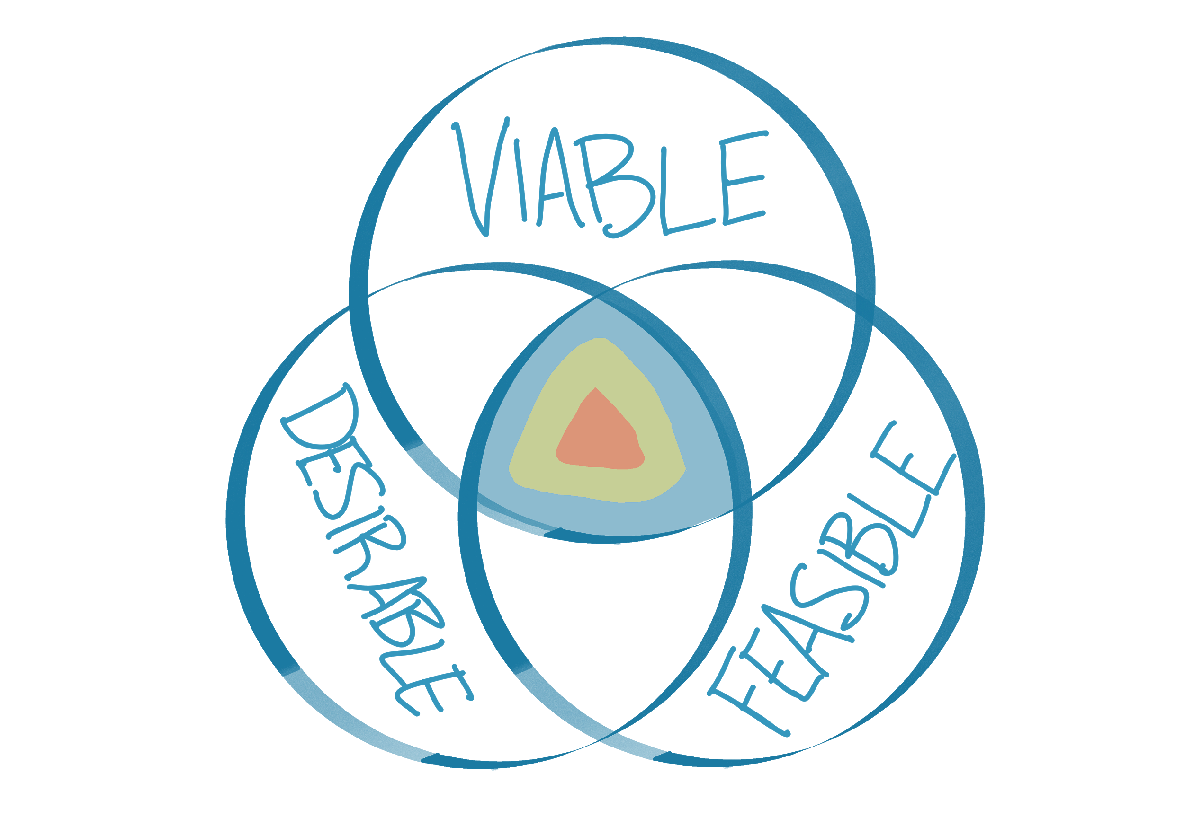
Target for Inclusive Problem-Solving

Slide 37
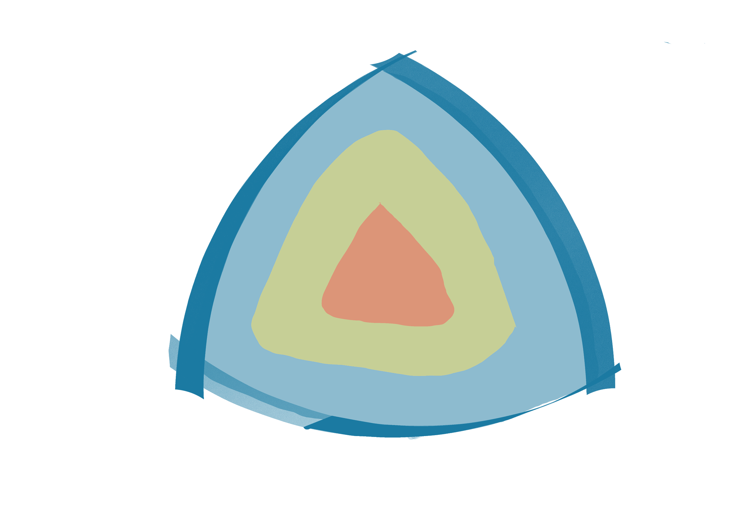
Inclusive Problem-Solving to Activate a Research Project
Communicate
Cooperate
Co-create
Coordinate
Collaborate
©2019 Impact360 Alliance. All rights reserved.

Slide 38
Inclusive Problem Solving to Initiate
New Research Projects

Slide 39
Converge
Translation and Knowledge Transfer is Not Enough
Co-create
Collaborate
Convergence Pyramid
Cooperate
Coordinate
Communicate

Slide 40
Converge
Translation and Knowledge Transfer is Not Enough
Co-create
Collaborate
Convergence Pyramid
Cooperate
Coordinate
Communicate

Slide 41
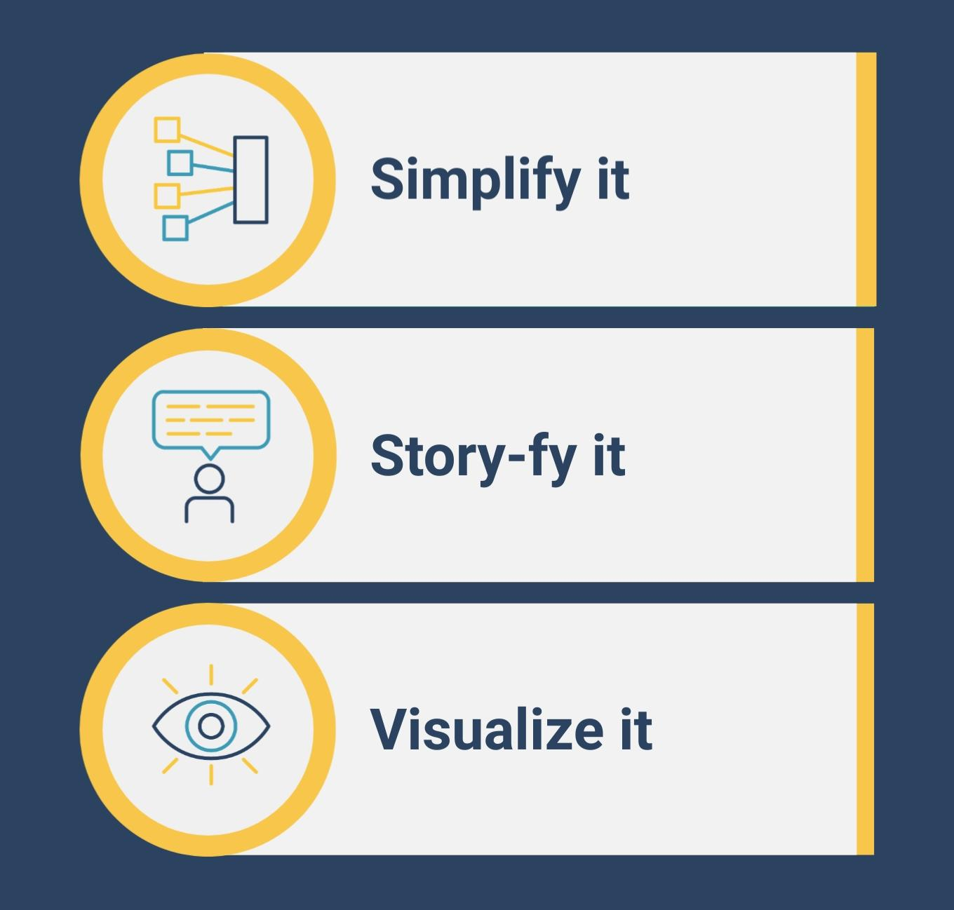
Inspiration to Climb the Convergence Pyramid

Slide 42
Hero’s Journey Story of Inclusive Problem-Solving

Slide 43
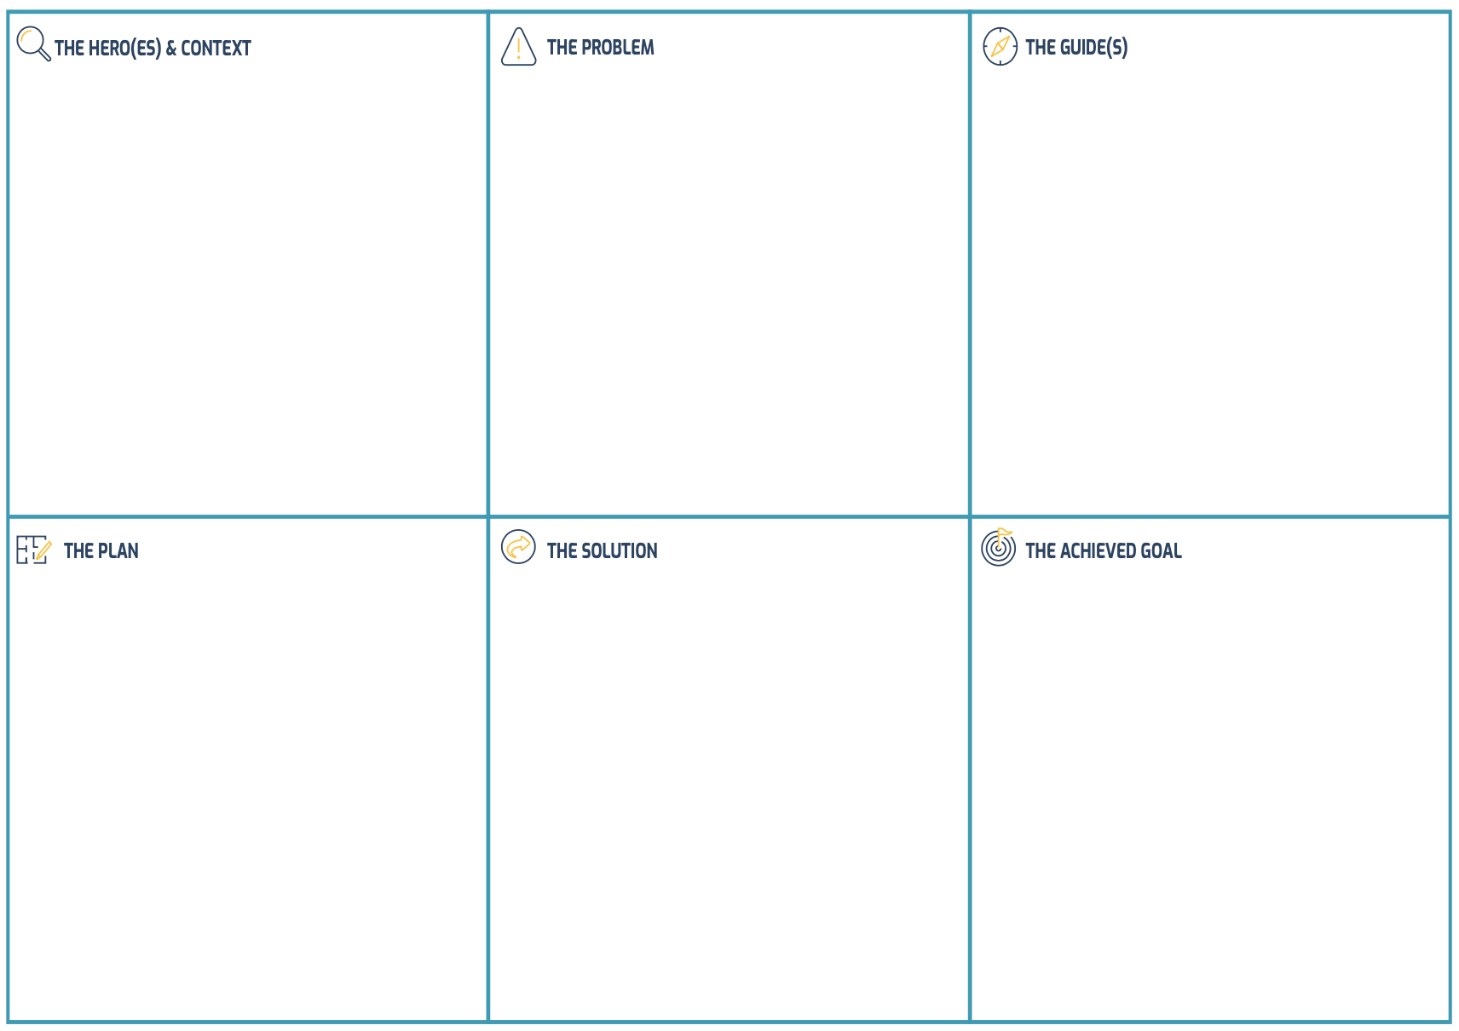
Hero’s Journey
Storyboard

Slide 44
Hero’s Journey Story of Inclusive Problem-Solving

Slide 46
Thank you!
impact360alliance.org
i360a
Impact360 Alliance
Impact360A

