Slide 1
Cultivating Our Legacy
Institutional Knowledge Transfer
Ron Timmons, Ph.D. February 18, 2019

Slide 2
Cultivating Legacy
The “WHY” To
Proud tradition established
Won acceptance
Proven value-3rd service
Now like a family business- handing off-next generation
Notes:
Emergency Management reputation first generation, hard-earned, third service, acceptance by First Responders Administration and the public
Similar to a business being handed down from one generation to the next
We're proving the value of building resilient communities optimizing post-disaster return to normalcy

Slide 3
All the best in your future endeavors...
Colleagues transitioning to retirement
Deep institutional knowledge
Systematic and gradual transfer best
Once announcement made- everything changes
Notes:
Colleagues transitioning to well-earned retirements. Deep institutional knowledge, must be systematically and gradually transferred. Once retirement is announced the dynamic changes.

Slide 4
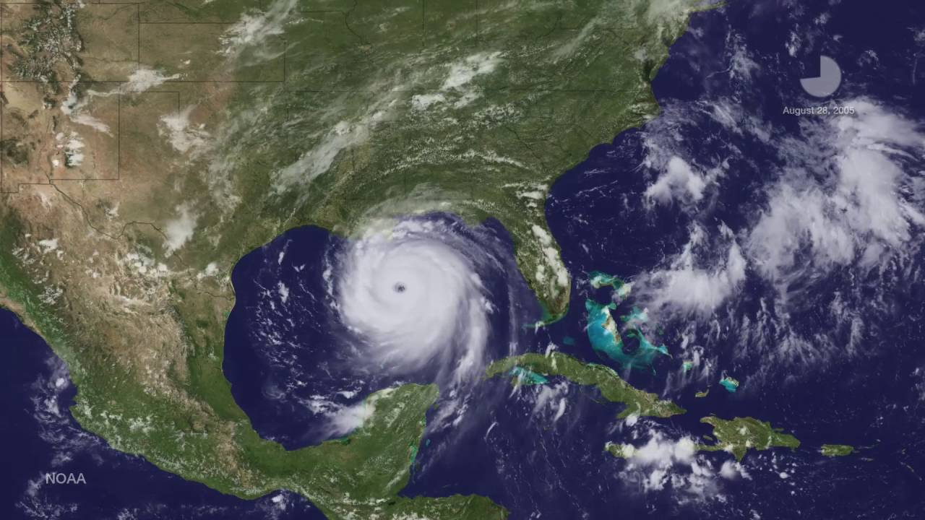
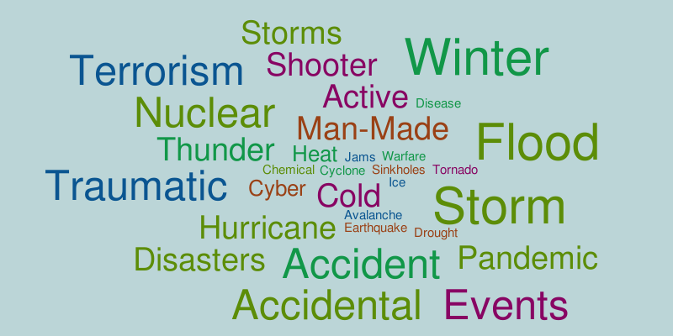
Focusing Events
9/11
Y2K
Columbine
Notes:
Focusing events- incidence of national significance, Public's attention is drawn, sense of urgency, changes in perceptions result, triggers political action. Examples Hurricane Andrew, Columbine, Y2K, 9/11, Hurricane Katrina. Before that: WWII, Cold War, H. Camille.

Slide 5
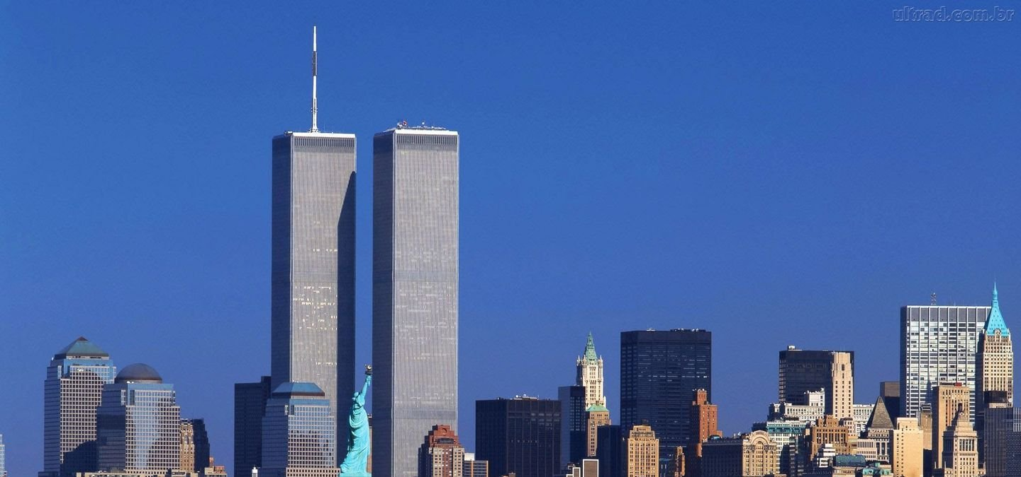
No one will forget…
…where they were on 9/11
…unless you were in the playpen
“I was in the first grade and only truly remember the stress of my parents …”
-UNT Student
Notes:
No one will forget where they were on 9/11
unless you were in the playpen
Today's college students where toddlers on 9/11. And today's new employees were in elementary school for Hurricane Katrina. This age cohort is soon to be a majority of Emergency Management staffs.

Slide 6
Next Generation
Different set of life experiences
Didn’t live through major disasters
21st century realities
Notes:
Issue- Next Generation has a different set of life experiences, and first-hand awareness of major emergency management milestones

Slide 7
Cultivating Legacy
The “HOW” To
How will you be remembered?
Facilitate program continuance
Leave your successor a strong base
Be deliberate about continuity
Notes:
Cultivating Legacy The “How” to
How will you be remembered?
Continue the passion and altruism that brought you to Emergency Management in the first place, long after you have stopped punching the time clock.
Will the continuity of the program be assured? Will your successors have a strong base to build from?

Slide 8
Knowledge Transfer
Start mid-career,
time goes fast
And life happens…
health issues
internal politics
sudden career changes
… trigger abrupt transition
Notes:
Knowledge Transfer. Start mid-career, time goes fast toward the end, other priorities pop-up. Health issues, internal politics, sudden career changes, can trigger abrupt transition

Slide 9
Emergency Management Program
Leave strong documentation, especially plans.
Staff development- take extra time to involve, delegate, engage.
Courage and confidence to share spotlight.
Provide internships and shadow opportunities: meetings, committees, budgeting.
Notes:
Emergency Management program
Strive to leave strong documentation, especially plans. Staff development- take extra time to involve, delegate. Have courage and confidence to share the spotlight. Provide shadow opportunities: meetings, committees, budget process.

Slide 10
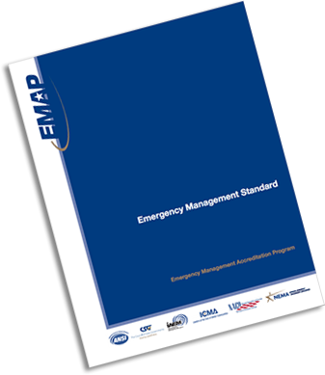
EMAP
Best practices
Outside scrutiny
Compels structure and documentation
Arlington, 2014
Austin, 2012
Dallas, 2016
Notes:
Consider program accreditation through EMAP. Provides best practices of our discipline, outside scrutiny, and compels structure and documentation for your successors.

Slide 11
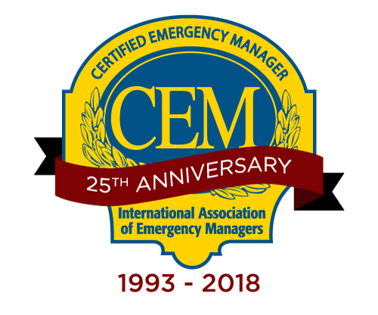
Contributions…Profession
Contributions to the profession (TEM/CEM Items)
Professional associations, membership and involvement
Local, regional, state committees
Publish your thoughts and experiences
Notes:
Contributions to the profession – CEM Items
Professional associations, membership and involvement
Local, Regional, State committees
Publish, transferring your experiences to a worldwide audience through internet exposure. Even if you're not a strong writer, there are resources available to get your thoughts into print

Slide 12
Encore Careers
Teach: College,
high school, EMI,
regionally
CERT classes
Peer training
Scouts
Exercise teams
Consultant
Notes:
Consider an encore career.
Teach: College, High School, CERT classes, specialty training for peers, scouts, participate on exercise teams, consultant.

Slide 13
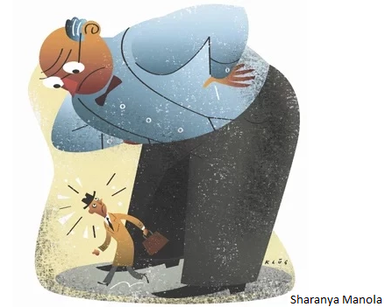
#1 Rule About Advice…
Avoid: Been there, done than, don’t bother
Maybe just one fluid factor is different
Just ahead of your time!
Notes:
Avoid your previous agency- your successor needs space. Offer advice, only if asked.
Don’t dwell on the failures of the past—“…tried that, won’t work…” mentality. World is a complex place, factors change; Think of it this way: Maybe you were just ahead of your time!

Slide 14
Recap
Continuity of operations includes home agency
Knowledge transfer - deliberate and continuous
Seek outlets for constructive contribution to the profession
Remain mindful of the differing generational perspectives
You play a key role in knowledge transfer, regardless of tenure and position

Slide 15
Emergency Administration
and Planning (BS)
Emergency Management and Disaster Science (MS)

Slide 16
Thank You
Ron Timmons Emergency Management and Disaster Science

Slide 17
9/11 college students’ recollections
- I was 6 years old and a first grader in Brooklyn NY, seeing teachers and staff crying and praying.
- I was 5 years old. I remember the teachers getting upset but I didn't know why and then my mom picking me up early from school.
- I (lived) in Mexico. I remember one of the teachers drooping to her knees crying. I remember seeing the rest of the kids screaming and yelling.
- I was 3 years old on 9/11 but I can recall the news interrupting my morning run of cartoons on PBS Kids. Frequently asking why they were showing the towers and my mom saying someone did something really bad.
- I can't say much about the 9/11 attacks because I was in the first grade and only truly remember the stress of my parents and my uncle soon being deployed afterwards for his first tour.
- I was living in Mexico at the time. I remember my mom looked scared and a couple of her friends started crying, I didn’t understand what was going on, all I remember was that I was scared because everyone else looked scared…
- I was in kindergarten and vaguely remember the day.
- I was 5 years old so I don't have the best recollection of what I was doing or going through at that point in my life.
- I don't really remember anything except leaving class early and my mom crying all night while watching the news. I later enlisted in the Marines.
- I was 5 years old and in preschool. I do not have any memories of the events …
- I was in the second grade …the school went on a full lock down
- I was in daycare as I was 4 at the time. I do not remember anything from that day.
- I was 3 or 4 and too young to understand the reasoning behind the attack.
- I do not remember it that well, but I remember that I was little frightened by it.

